Slide 1
Module 4: Implement the DiffServ QoS Model
Lesson 4.7: Mechanizmy Policing a Shaping

Slide 2
Nástroje na obmedzovanie prevádzky
Policing (limitovanie prevádzky)
Obmedzuje objem prevádzky jej zahadzovaním
Umožňuje prevádzku podľa jej zhody s profilom (tzv. konformity) preznačkovávať a odoslať
Používaný často na vysokorýchlostných rozhraniach
Môže byť použitý vo vstupnom i výstupnom smere
Shaping (tvarovanie prevádzky)
Obmedzuje objem prevádzky jej odložením na neskoršie odoslanie (môže viesť k zvýšeniu oneskorenia)
Spravidla používaný na pomalých rozhraniach
Nemôže preznačkovávať prevádzku
Môže byť použitý len vo výstupnom smere
Notes:
Traffic conditioners, QoS mechanisms that limit bandwidth, include policing and shaping. Both of these approaches limit bandwidth, but each has different characteristics, as follows:
Policing: Policing typically limits bandwidth by discarding traffic that exceeds a specified rate. However, policing also can re-mark traffic that exceeds the specified rate and attempt to send the traffic anyway. Because of the drop behavior of policing TCP retransmits, policing should be used on higher-speed interfaces. Policing can be applied inbound or outbound on an interface. Traffic policing tools are often configured on interfaces at the edge of a network to limit the rate of traffic entering or leaving the network. In the most common traffic-policing configurations, traffic that conforms is transmitted and traffic that exceeds is sent with a decreased priority or is dropped. Such priorities can be based on IP precedence or DSCP.
Shaping: Shaping limits excess traffic, not by dropping it but by buffering it. This buffering of excess traffic can lead to delay. Because of this delay, shaping is recommended for slower-speed interfaces. Unlike policing, shaping cannot re-mark traffic. As a final contrast, shaping can be applied only in the outbound direction on an interface. Traffic shaping can be used to account for speed mismatches, which are common in nonbroadcast multiaccess (NBMA) networks such as Frame Relay and ATM.

Slide 3
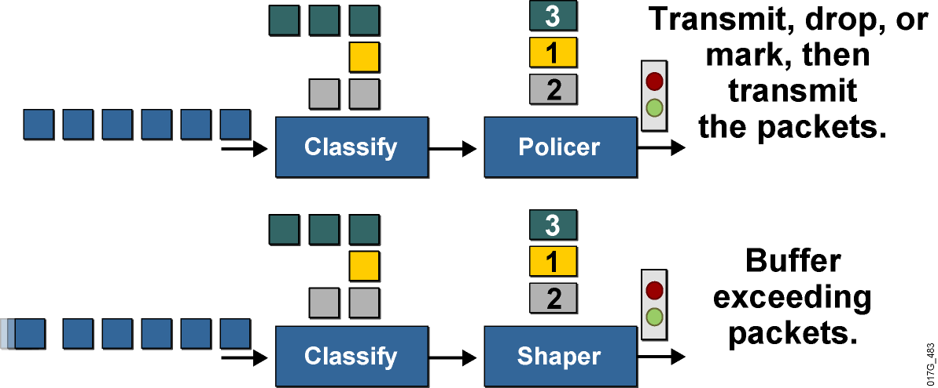
Policing a shaping – mechanizmy obmedzovania prevádzky
Policing môže pakety nielen zahodiť, ale na základe preddefinovaných pravidiel aj merať a prípadne preznačkovávať
Preznačkovávanie sa deje na základe tzv. konformity (conform, exceed, violate)
Hovoríme o tzv. meteringu
Shaping pakety len odkladá, no preznačkovávať ich nevie
Notes:
Both traffic shaping and policing mechanisms are traffic-conditioning mechanisms that are used in a network to control the traffic rate. Both mechanisms use classification so that they can differentiate traffic. They both measure the rate of traffic and compare that rate to the configured traffic-shaping or traffic-policing policy.
The difference between traffic shaping and policing can be described in terms of their implementation. Traffic policing drops excess traffic to control traffic flow within specified rate limits. Traffic policing does not introduce any delay to traffic that conforms to traffic policies. Traffic policing can cause more TCP retransmissions, because traffic in excess of specified limits is dropped.
Traffic-policing mechanisms such as class-based policing or committed access rate (CAR) also have marking capabilities in addition to rate-limiting capabilities. Instead of dropping the excess traffic, traffic policing can mark and then send the excess traffic. This feature allows the excess traffic to be re-marked with a lower priority before the excess traffic is sent out.
Traffic shaping buffers excessive traffic so that the traffic stays within the desired rate. With traffic shaping, traffic bursts are smoothed out by queuing the excess traffic to produce a steadier flow of data. Reducing traffic bursts helps reduce congestion in the network. Traffic shapers such as class-based shaping, Frame Relay traffic shaping (FRTS), or virtual IP (VIP)-based distributed traffic shaping (DTS) in Cisco IOS software do not have the ability to mark traffic.

Slide 4
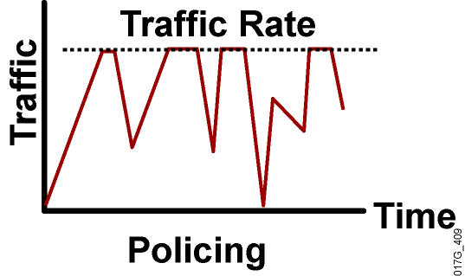
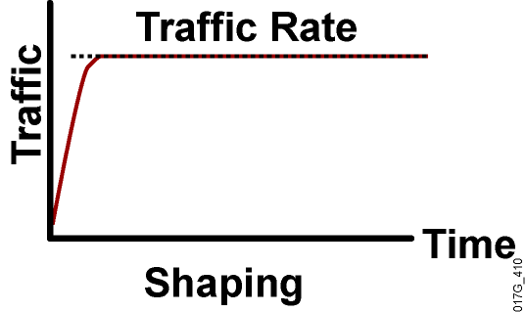
Porovnanie policingu a shapingu
Policing je možné použiť na vstupe aj výstupe rozhrania
Pakety nie sú odkladané „na neskôr“ – buď budú odoslané alebo zahodené
Pri spoľahlivých protokoloch straty povedú k retransmisiám paketov
Shaping je možné použiť iba na výstupe
Pakety presahujúce profil budú odložené na neskoršie odoslanie, kým je vo fronte miesto
Buffering zmenšuje počet retransmisií
Notes:
Policing can be applied to either the inbound or outbound direction, while shaping can be applied only in the outbound direction. Policing drops nonconforming traffic instead of queuing the traffic like shaping. Policing also supports marking of traffic. Traffic policing is more efficient in terms of memory utilization than traffic shaping because no additional queuing of packets is needed.
Both traffic policing and shaping ensure that traffic does not exceed a bandwidth limit, but each mechanism has different impacts on the traffic:
Policing drops packets more often, generally causing more retransmissions of connection-oriented protocols, such as TCP.
Shaping adds variable delay to traffic, possibly causing jitter. Shaping queues excess traffic by holding packets in a shaping queue. Traffic shaping is used to shape the outbound traffic flow when the outbound traffic rate is higher than a configured rate. Traffic shaping smoothes traffic by storing traffic above the configured rate in a shaping queue. Therefore, shaping increases buffer utilization on a router and causes unpredictable packet delays. Traffic shaping can also interact with a Frame Relay network, adapting to indications of Layer 2 congestion in the WAN. For example, if the backward-explicit congestion notification (BECN) bit is received, the router can lower the rate limit to help reduce congestion in the Frame Relay network.

Slide 5
Prečo policing? Prečo shaping?
Cielené obmedzovanie rýchlosti, ak prístupová technológia je rýchlejšia než poskytovaná služba (tzv. subrate access)
Obmedzovanie maximálneho pásma, ktoré môže vybraná trieda na rozhraní obsadiť
Preznačkovanie excesívnej prevádzky do inej triedy
Predchádzanie zahlteniu a najmä stratám na pomalších rozhraniach
ATM, Frame Relay, Metro Ethernet
Prispôsobenie objemu odosielanej prevádzky poskytovanej rýchlosti (committed rate) poskytovateľa
Na logických rozhraniach (tunely, subinterfejsy), ktoré nemajú fyzický front a nemajú ako vytvoriť backpressure
Notes:
Why Use Policing?
Limiting the access rate on an interface when high-speed physical infrastructure is used in transport. Rate limiting is typically used by service providers to offer customers subrate access. For example, a customer may have an Optical Carrier-3 (OC-3) connection to the service provider but pay only for a T1 access rate. The service provider can rate-limit the customer traffic to T1 speed.
Engineering bandwidth so that traffic rates of certain applications or classes of traffic follow a specified traffic-rate policy. For example, traffic from file-sharing applications may be rate-limited to 64 kbps maximum.
Re-marking excess traffic with a lower priority at Layer 2 and Layer 3 or both before sending the excess traffic out. Cisco class-based traffic policing can be configured to mark packets at both Layer 2 and Layer 3. For example, excess traffic can be re-marked to a lower differentiated services code point (DSCP) value and also have the Frame Relay discard eligible (DE) bit set before the packet is sent out.
Why Use Shaping?
Traffic shaping is typically used to prevent and manage congestion in ATM, Frame Relay, or Metro Ethernet networks, where asymmetric bandwidths are used along the traffic path. If shaping is not used, then buffering can occur at the slow (usually the remote) end, which can lead to queuing and cause delays, and overflow, which can cause packet drops.
Traffic shaping is an attempt to control traffic in ATM, Frame Relay, or Metro Ethernet networks to optimize or guarantee performance, low latency, or bandwidth. Traffic shaping deals with the concepts of classification, queue disciplines, enforcing policies, congestion management, quality of service (QoS), and fairness.
Traffic shaping provides a mechanism to control the volume of traffic being sent into a network (bandwidth throttling) by not allowing the traffic to burst above the subscribed (committed) rate. For this reason, traffic-shaping schemes need to be implemented at the network edges, as with ATM, Frame Relay, or Metro Ethernet, to control the traffic entering the network. It also may be necessary to identify traffic with a granularity that allows the traffic-shaping control mechanism to separate traffic into individual flows and shape them differently.

Slide 6
Mechanizmus Token Bucket
Token Bucket je elementárny stavebný mechanizmus (a matematický model) pre policing a shaping
Pojem „token“ označuje povolenie odoslať istý objem dát (spravidla jeden bit)
Pojem „token bucket“ označuje zásobáreň tokenov pre okamžité použitie
Tokeny do token bucketu dopĺňa v istých intervaloch operačný systém (spôsob dopĺňania sa v policingu a shapingu líši)
Na odoslanie paketu určitej veľkosti musí byť v token buckete prítomný počet tokenov zodpovedajúci veľkosti paketu, ktoré sa na odoslanie tohto paketu spotrebujú (odoberú)
Ak na odoslanie paketu nie je v token buckete dostatok tokenov, udeje sa obmedzovacia operácia (zahodenie, odloženie na neskôr, preznačkovanie)
Notes:
The token bucket is a mathematical model used by routers and switches to regulate traffic flow. The model has two basic components:
Tokens: Each token represents permission to send a fixed number of bits into the network. Tokens are put into a token bucket at a certain rate by Cisco IOS software.
Token bucket: A token bucket has the capacity to hold a specified number of tokens. Each incoming packet, if forwarded, takes tokens from the bucket representing the packet size. If the bucket fills to capacity, newly arriving tokens are discarded. Discarded tokens are not available to future packets. If there are not enough tokens in the token bucket to send the packet, the traffic-conditioning mechanisms may take the following actions:
Wait for enough tokens to accumulate in the bucket (traffic shaping)
Discard the packet (traffic policing)
Using a single token bucket model, the measured traffic rate can conform to or exceed the specified traffic rate. The measured traffic rate is conforming if there are enough tokens in the token bucket to transmit the traffic. The measured traffic rate is exceeding if there are not enough tokens in the token bucket to transmit the traffic.

Slide 7
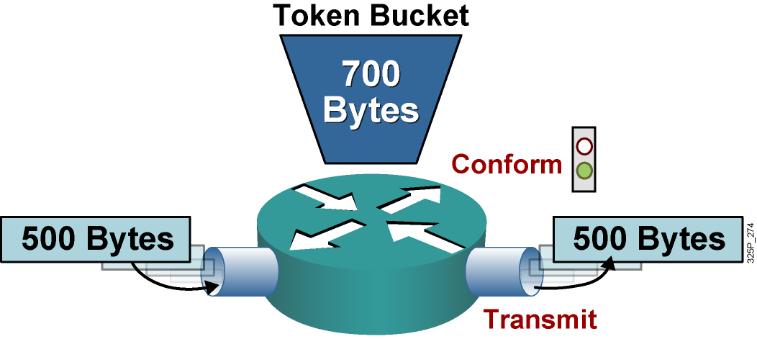
Jednoduchý Token Bucket (conform action)
Ak je v token buckete pre prechádzajúci paket dostatočný počet tokenov, vykoná sa tzv. conform action:
Z token bucket sa odoberie príslušný počet tokenov
Paket bude odoslaný
V tomto príklade v token buckete po prechode paketu zostane 200 tokenov
Notes:
This graphic shows a single token bucket traffic policing implementation.
Starting with a current capacity of 700 bytes worth of tokens accumulated in the token bucket, when a 500-byte packet arrives at the interface, its size is compared to the token bucket capacity (in bytes).
The 500-byte packet conforms to the rate limit (500 bytes is less than 700 bytes), and the packet is forwarded: 500 bytes worth of tokens are taken out of the token bucket, leaving 200 bytes worth of tokens for the next packet.

Slide 8
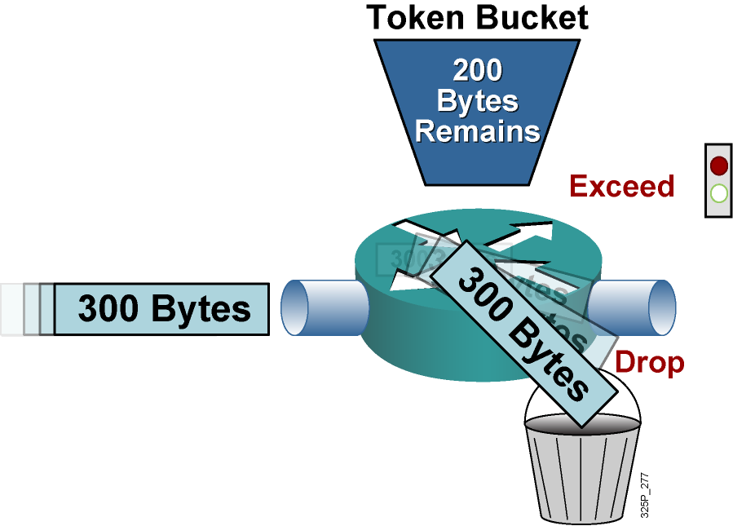
Jednoduchý Token Bucket (exceed action)
Ak v token buckete pre prechádzajúci paket nie je dostatočný počet tokenov, vykoná sa tzv. exceed action:
Paket bude zahodený alebo preznačkovaný a odoslaný
Tokeny z token bucketu sa neodoberú
Notes:
Continuing with the single token bucket example from the previous figure, when the next 300-byte packet arrives immediately after the first packet, no new tokens have been added to the bucket (which is done periodically).
This packet exceeds the rate limit. The current packet size (300 bytes) is greater than the current capacity of the token bucket (200 bytes), and the exceed action is performed.
In traffic policing, the exceed action can be to drop or mark the packet.

Slide 9
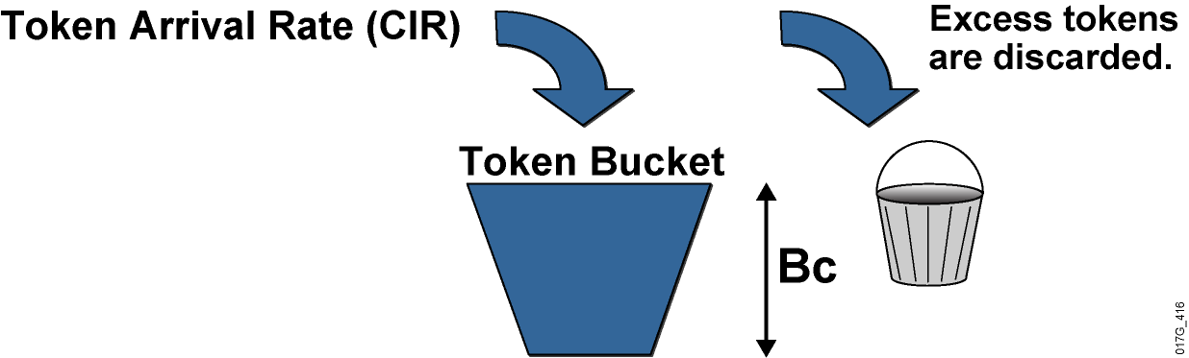
Parametre jednoduchého token bucketu
Mechanizmus token bucketu je popísaný tromi premennými
Bc, tzv. Committed Burst, je maximálny objem token bucketu [b]
Tc, tzv. Committed Time, je interval medzi doplnením Bc tokenov do token bucketu [s]
Každých Tc sekúnd sa do token bucketu doplní Bc tokenov
Tokeny, ktoré sa do token bucketu nezmestia, sa zahodia
CIR, tzv. Committed Information Rate, je dosiahnuteľná priepustnosť [b/s]
Platí: CIR = Bc / Tc , resp. CIR = Bc * (1/Tc), resp. CIR * Tc = Bc
Notes:
Token bucket operations rely on parameters such as CIR, committed burst (Bc), and committed time interval (Tc). Bc is known as the normal burst size. The mathematical relationship between CIR, Bc, and Tc is as follows:
CIR (bps) = Bc (bits) / Tc (sec)
With traffic policing, new tokens are added into the token bucket based on the interpacket arrival rate and the CIR. Every time a packet is policed, new tokens are added back into the token bucket. The number of tokens added back into the token bucket is calculated as follows:
(Current Packet Arrival Time – Previous Packet Arrival Time) * CIR
An amount (Bc) of tokens is forwarded without constraint in every time interval (Tc). For example, if 8000 bits (Bc) worth of tokens are placed in the bucket every 250 ms (Tc), the router can steadily transmit 8000 bits every 250 ms if traffic arrives constantly at the router.
CIR (normal burst rate) = 8,000 bits (Bc) / 0.25 seconds (Tc) = 32 kbps
When configuring Cisco IOS class-based traffic policing, it is recommended that you allow Cisco IOS software to automatically calculate the optimal Bc and Tc value based on the configured CIR.
Without any excess bursting capability, if the token bucket fills to capacity (Bc of tokens), the token bucket overflows and newly arriving tokens are discarded. Using the example, in which the CIR is 32 kbps (Bc = 8000 bits and Tc = 0.25 seconds), the maximum traffic rate can never exceed a hard rate limit of 32 kbps.

Slide 10
Dopĺňanie tokenov pri policingu
Pri policingu sa do token bucketu pridávajú tokeny priebežne tak, aby sa za čas Tc pridalo Bc tokenov
Ak t je čas od posledného úspešného odoslania paketu, do token bucketu pribudlo Bc*(t/Tc) tokenov (priama úmera – za čas Tc pribudne práve Bc tokenov)
Ak b je momentálny objem tokenov v token buckete, v čase t bude v token buckete MIN (b + Bc*(t/Tc), Bc) tokenov (nemôže v ňom byť viac ako Bc tokenov)
Práve prichádzajúci paket o veľkosti P bude odoslaný, ak P <= MIN (b + Bc*(t/Tc), Bc)

Slide 11
Zložitejšie systémy token bucketov
Elementárny token bucket je prirodzený spôsob na obmedzenie prevádzky
Dá sa nazvať aj Single Rate Two Color Marker – konformné dáta sú „zelené“, nekonformné dáta sú „červené“
Má však niekoľké obmedzenia
Nedokáže zužitkovať nevyužité tokeny ušetrené za dlhšiu dobu
Nedokáže rozoznávať viaceré ustálené intenzity toku pre viac farieb („žlté/oranžové“ dáta nad dohodnutý objem)
V praxi sa preto využívajú zložitejšie systémy token bucketov
Single Rate Three Color Marker (srTCM, RFC 2697)
Two Rate Three Color Marker (trTCM, RFC 2698)

Slide 12
Single Rate Three Color Marker (srTCM)
Ideou srTCM je nevyužité tokeny odložiť do rezervy a využiť v časoch vyššej spotreby
srTCM využíva dva token buckety, jeden s veľkosťou Bc, druhý s veľkosťou Be (Excess Burst)
Token bucket Bc sa napĺňa ako prvý s intenzitou CIR
Token bucket Be sa napĺňa len z tokenov pridávaných do bucketu Bc, ktoré sa už doň nezmestili
Spôsob použitia token bucketov:
Ak je pre paket dosť tokenov v buckete Bc, paket je „zelený“ (conform) a bude odoslaný. Z bucketu Bc sa odoberie zodpovedajúci počet tokenov
Inak, ak je pre paket dosť tokenov v buckete Be, paket je „oranžový“ (exceed) a bude odoslaný. Z bucketu Be sa odoberie zodpovedajúci počet tokenov.
Inak je paket „červený“ (violate) a bude zahodený
Be

Slide 13
Single Rate Three Color Marker (srTCM)
Parametre modelu srTCM
Bc – veľkosť token bucketu Bc (veľkosť konformného zhluku)
Be – veľkosť token bucketu Be (veľkosť nekonformného, ale povoleného zhluku)
CIR – ustálená rýchlosť pri trvalom preťažení
CIR, Bc a Tc sú viazané vzťahom CIR=Bc/Tc, preto Tc nie je voľným parametrom modelu
Priepustnosť modelovaná v srTCM
Ustálená: CIR = Bc/Tc
Maximálna: až do rýchlosti rozhrania (pri dostatočne veľkom Be)
Maximálna rýchlosť nie je trvale udržiavateľná

Slide 14
Two Rate Three Color Marker (trTCM)
Ideou trTCM je obmedziť tok na maximálnu ustálenú úroveň PIR, no pritom identifikovať jeho časť na ustálenej úrovni CIR, CIR < PIR
trTCM využíva dva token buckety, jeden s veľkosťou Bc, druhý s veľkosťou Be
Každý sa napĺňa nezávisle svojou vlastnou intenzitou, bucket Bc intenzitou CIR, bucket Be intenzitou PIR
Spôsob použitia token bucketov:
Ak pre paket nie je dosť tokenov v buckete Be, paket je „červený“ (violate) a bude zahodený
Inak ak pre paket nie je dosť tokenov v buckete Bc, paket je „oranžový“ (exceed) a bude odoslaný. Z bucketu Be sa odoberie zodpovedajúci počet tokenov
Inak je paket „zelený“ (conform) a bude odoslaný. Z bucketov Be aj Bc sa odoberie rovnaký zodpovedajúci počet tokenov.
CIR
PIR
Be

Slide 15
Two Rate Three Color Marker (trTCM)
Parametre modelu trTCM
Bc – veľkosť token bucketu Bc (veľkosť konformného zhluku)
Be – veľkosť token bucketu Be (veľkosť nekonformného, ale povoleného zhluku)
CIR – ustálená rýchlosť na konformnej úrovni
PIR – ustálená rýchlosť na maximálnej povolenej úrovni

Slide 16
Konfigurácia policingu
Single Rate Two Color (jeden token bucket)
Single Rate Three Color (dva token buckety Bc a Be)
Router(config-pmap-c)#
police cir CIR [[bc] Bc] ! CIR je v bps, Bc je v Bps
conform-action transmit
exceed-action drop
Router(config-pmap-c)#
police cir CIR [bc] Bc [be] Be
conform-action transmit
exceed-action ... ! Typicky remarking a transmit
violate-action drop

Slide 17
Konfigurácia policingu
Two Rate Three Color (dva token buckety, CIR a PIR)
Akcie:
Router(config-pmap-c)#
police cir CIR [[bc] Bc] pir PIR be Be
conform-action transmit
exceed-action ... ! Typicky remarking a transmit
violate-action drop
Router(config-pmap-c-police)#
drop drop packet
set-clp-transmit set atm clp and send it
set-cos-transmit set cos and send it
set-discard-class-transmit set discard-class and send it
set-dscp-transmit set dscp and send it
set-dscp-tunnel-transmit rewrite tunnel packet dscp and send it
set-frde-transmit set FR DE and send it
set-mpls-exp-imposition-transmit set exp at tag imposition and send it
set-mpls-exp-topmost-transmit set exp on topmost label and send it
set-prec-transmit rewrite packet precedence and send it
set-prec-tunnel-transmit rewrite tunnel packet precedence and send
it
set-qos-transmit set qos-group and send it
transmit transmit packet

Slide 18
Shaping
Shaping je implementovaný obdobne ako policing pomocou jednoduchého token bucketu
Na rozdiel od policingu sa však token bucket v policingu dopĺňa len diskrétne, v intervaloch Tc
V základnom shapingu je token bucket iba jeden, avšak jeho veľkosť je vždy Bc+Be
Parametre: CIR, Bc, Be
Dopĺňanie token bucketu sa líši podľa príkazu
shape average doplní Bc tokenov každých Tc sekúnd
shape peak doplní Bc+Be tokenov každých Tc sekúnd
Výsledná rýchlosť:
shape average: CIR = Bc/Tc
shape peak: CIR’ = (Bc+Be)/Tc = = (Bc+Be)/(Bc/CIR) = CIR(1+Be/Bc)

Slide 19
Konfigurácia traffic shapingu
Shaping:
Zopár poznámok na záver
Pozor na jednotky!
V policingu sú CIR a PIR v bps (bity/s), Bc a Be v Bps (bajty/s)
V shapingu sú všetky parametre v bps (bity/s)
Explicitný policing sa aktivuje vždy na rozdiel implicitného policera v triede využívajúcej príkaz priority (tzn. nemusí dôjsť k zahlteniu, aby sa explicitný policer aktivoval)
Implicitne je v shapingu Bc=Be
Router(config-pmap-c)#
shape { average | peak } CIR Bc Be ! Všetko v bps

Slide 20
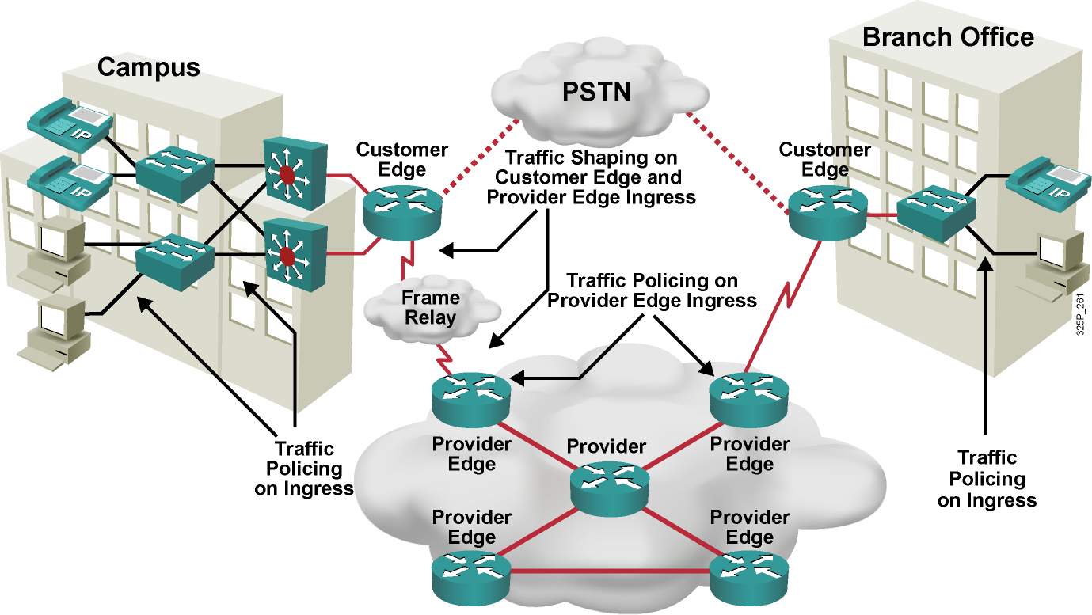
Použitie obmedzovania prevádzky
Notes:
This example shows how traffic policing is often implemented in an enterprise network. Typically, the access or distribution layer employs traffic policing to limit certain traffic classes before that traffic exits the campus onto the WAN. Traffic shaping is often implemented at the WAN edge when there are speed mismatches or oversubscription.
In a typical service provider network, traffic policing is often implemented inbound at the Provider Edge (PE) router to rate-limit incoming traffic from the Customer Edge (CE) router to ensure that the customer traffic rate is not exceeding the contractual rate. Traffic shaping is often implemented outbound at the Provider Edge and at the Customer Edge to limit the traffic rate between the Provider Edge and Customer Edge and to allow for FRF.12 fragmentation on Frame Relay connections between the Customer Edge and Provider Edge.

Slide 21
Link Efficiency Mechanisms
Link efficiency mechanisms are often deployed on WAN links to increase the throughput and to decrease delay and jitter.
Cisco IOS link efficiency mechanisms include:
Layer 2 payload compression
Header compression
Link Fragmentation and Interleaving (LFI)
Notes:
WAN links can use bandwidth optimizing link efficiency QoS mechanisms such as payload compression, header compression, and link fragmentation and interleaving (LFI). These features are applicable to low-speed WAN interfaces and are emerging for use on high-speed Ethernet interfaces.
Payload compression: Payload compression does create additional bandwidth, because it squeezes packet payloads, and therefore increases the amount of data that can be sent through a transmission resource in a given time period. Payload compression is mostly performed on Layer 2 frames and, as a result, compresses the entire Layer 3 packet.
Header compression: The basis of header compression, like other compression methods, is the elimination of redundancy. This applies especially to often-repeated protocol headers.
LFI: LFI is a Layer 2 technique in which large frames are broken into small, equal-sized fragments and transmitted over the link in an interleaved fashion. The three primary LFI mechanisms supported by Cisco are as follows:
Multilink PPP (MLP): Used on PPP links
FRF.12: Used on Voice over IP over Frame Relay (VoIPovFR) links
FRF.11 Annex C: Used on Voice over Frame Relay (VoFR) links

Slide 22
Compression
Data compression works by the identification of patterns in a stream of data.
Basic elements of compression:
Remove redundancy as much as possible.
There is a theoretical limit, known as Shannon's limit.
Many compression algorithms exist, for different purposes:
MPEG compression for video
Huffmann compression for text and software
LZ compression, used in Stacker compression
Two methods of compression are used:
Hardware compression
Software compression
Notes:
Data compression works by identifying patterns in streams of data, and then chooses a more efficient method to represent the same information. Essentially, a compression algorithm removes as much redundancy as possible. The compression ratio measures the efficiency and effectiveness of a compression scheme—the ratio of the size of uncompressed data to compressed data. A compression ratio of 2:1 (which is relatively common) means that the compressed data is half the size of the original data.
Several compression algorithms exist. Some algorithms take advantage of a specific medium and the redundancies found in it. For example, the MPEG standard takes advantage of the relatively small difference between one frame and another in video data.
One of the most important concepts in compression theory is that there is a theoretical limit, known as Shannon's limit, which describes how far a given source of data can be compressed. Modern compression algorithms coupled with the fast processors available today allow compression to approach Shannon’s limit.
Hardware compression and software compression refer to the site in the router to which the compression algorithm is applied. In software compression, compression is implemented in the main CPU as a software process. In hardware compression, the compression computations are off-loaded to a secondary hardware module. This frees the central CPU from the computationally intensive task of calculating compression.

Slide 23
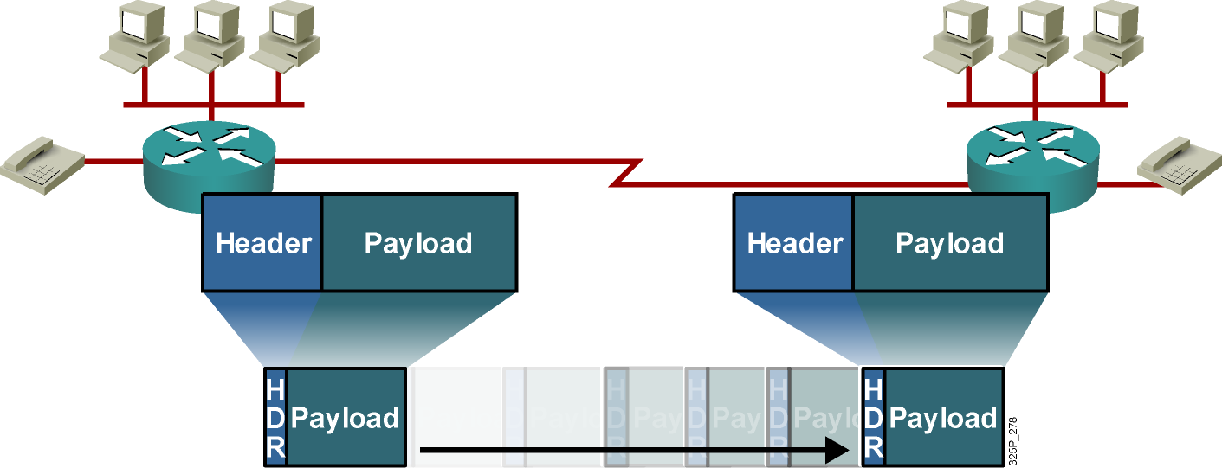
Payload and Header Compression
Payload compression reduces the size of the payload.
Header compression reduces the header overhead.
Compression increases throughput and decreases latency.
Notes:
Payload compression squeezes payloads, either the Layer 2 payload or the Layer 3 payload. With Layer 2 payload compression, the Layer 2 header remains intact, but its payload (Layer 3 and above) is compressed. With Layer 3 payload compression, Layer 2 and 3 headers remain intact. Payload compression increases the throughput and decreases the latency in transmission, because smaller packets (with compressed payloads) take less time to transmit than the larger, uncompressed packets. Layer 2 payload compression is performed on a link-by-link basis, whereas Layer 3 payload compression is generally used on a session-by-session basis.
Header compression methods work by not transmitting repeated information in packet headers throughout a session. The two peers on a PPP Layer 2 connection (a dialup link) agree on session indices that index a dictionary of packet headers. The dictionary is built at the start of every session and is used for all subsequent (noninitial) packets. Only changing, or nonconstant, parameters in the headers are actually sent along with the session index.
Header compression cannot be performed across multiple routers because routers need full Layer 3 header information to be able to route packets to the next hop.

Slide 24
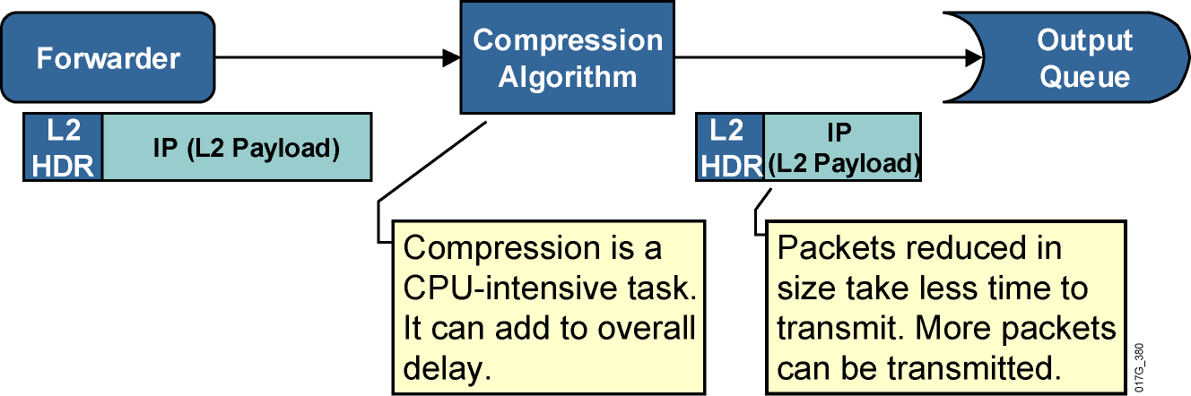
Layer 2 Payload Compression
Layer 2 payload compression reduces the size of the frame payload.
Entire IP packet is compressed.
Software compression can add delay because of its complexity.
Hardware compression reduces the compression delay.
Serialization delay is reduced; overall latency might be reduced.
Notes:
When a router forwards a packet, the packet is subjected to the Layer 2 compression method after it has been encapsulated at the output. The compression method squeezes the payload of the Layer 2 frame (the entire Layer 3 packet), and transmits the packet on the interface.
Layer 2 payload compression is a CPU-intensive task and can add per-packet compression delay because of the application of the compression method to each frame. The serialization delay, however, is reduced, because the resulting frame is smaller. Serialization delay is the fixed delay that is required to clock the frame onto the network interface. Depending on the complexity of the Layer 2 payload compression algorithm, overall latency might be reduced, especially on low-speed links.
Layer 2 payload compression involves the compression of the payload of a Layer 2 WAN protocol, such as PPP, Frame Relay, High-Level Data Link Control (HDLC), X.25, and Link Access Procedure, Balanced (LAPB). The Layer 2 header is untouched by the act of compression. However, the entire contents of the payload (which include higher-layer protocol headers) are compressed. They are compressed using either a form of the Stacker algorithm (based on the industry standard LZ algorithm) or the Predictor algorithm, which is an older algorithm that is mostly used in legacy configurations.

Slide 25
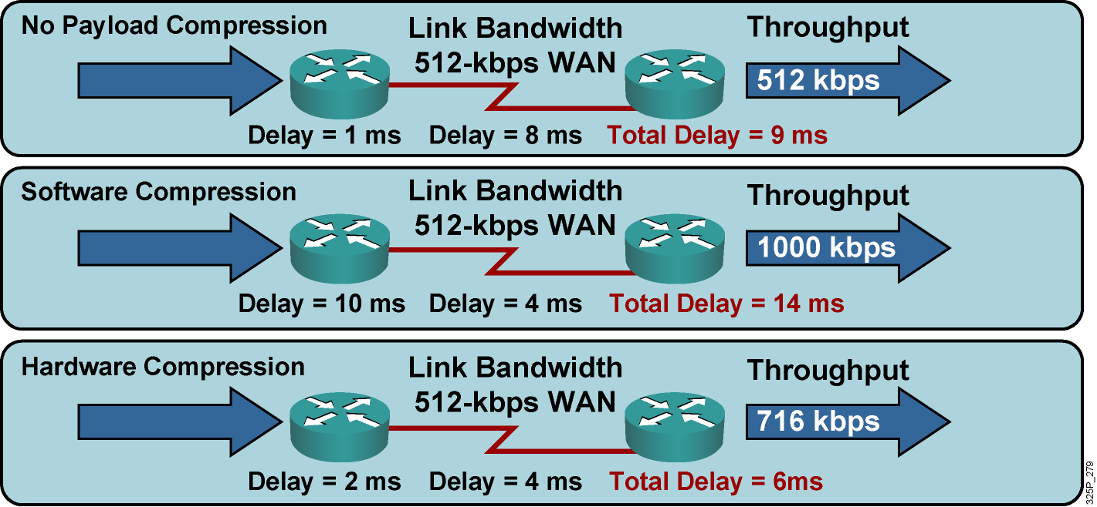
Layer 2 Payload Compression Results
Compression increases throughput and decreases delay.
Use hardware compression when possible.
Examples are Stacker, Predictor, and MPPC.
Notes:
If no compression is used, throughput is limited by the link bandwidth, and the average delay is influenced by forwarding or buffering delay, serialization, and propagation delay.
If compression is enabled—even if the serialization delay is now shorter because the frame is smaller—the compression or decompression delay may increase the overall latency between the two hops. The perceived throughput is generally increased because the size of the Layer 2 payload is reduced, allowing more Layer 2 frames to be sent through a transmission resource in a given time period. Throughput is limited by the effectiveness of the Layer 2 payload-compression algorithm and may be significantly higher than the link bandwidth limit.
If hardware-assisted Layer 2 payload compression is used, compression or decompression delays may become insignificant compared to forwarding and serialization delays, and overall latency may decrease.

Slide 26
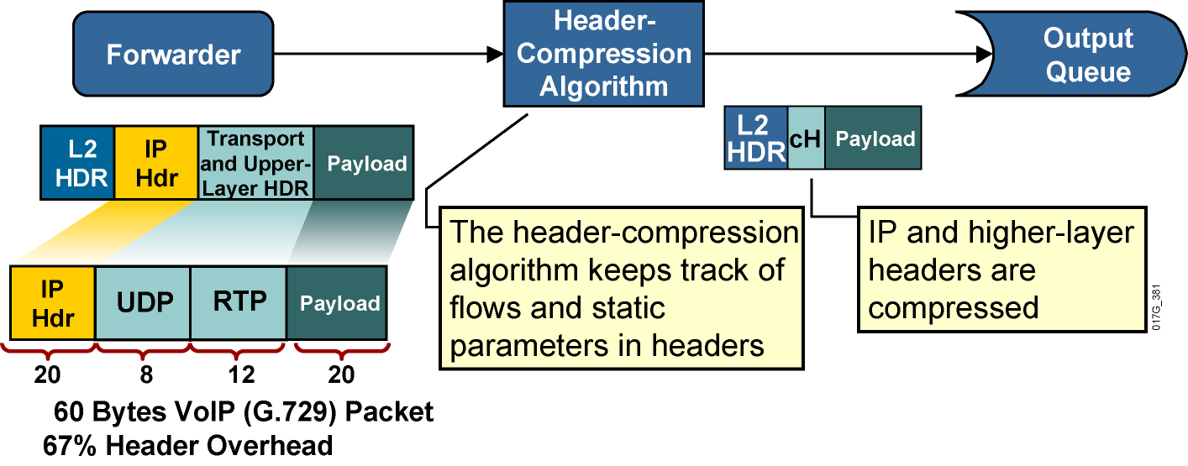
Header Compression
.
.
Notes:
Header compression increases throughput and reduces delay by compressing the protocol headers. Header compression is most useful for applications that generate small payloads because the protocol headers of such applications use a significant percentage of bandwidth on a link relative to their payload.
When header compression is applied on a TCP/IP header, some of the redundant fields in the header of a TCP/IP connection are removed. Header compression keeps a copy of the original header on either side of the link, removes the entirely redundant fields, and differentially codes the remaining fields in order to allow the compression of 40 bytes of header to an average of 5 bytes. This process uses a very specific algorithm designed around the constant structure of the TCP/IP header. It does not touch the payload of the TCP packet in any way.
TCP and RTP header compression applies to all TCP and RTP flows. For example, if TCP compression is enabled on a link, there is no mechanism to restrict its function to specific application types. TCP header compression for bulk data transfer yields little bandwidth savings. Class-based TCP header compression can be performed on specific traffic classes, such as the Telnet traffic class.
Class-based TCP header compression allows configuring RTP or TCP IP header compression on a per-class basis, when a class is configured within a policy map.

Slide 27
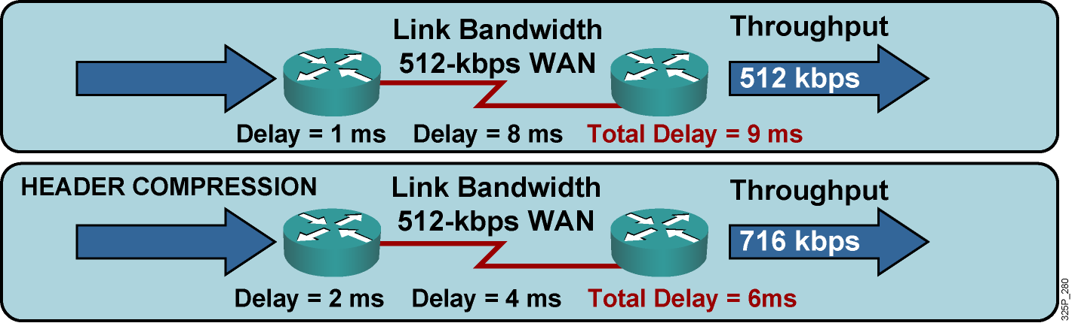
Header Compression Results
Header compression increases compression delay and reduces serialization delay.
Notes:
This graphic compares two throughput and latency scenarios on a WAN link.
If header compression is not used, throughput is limited by the link bandwidth, and the average delay is influenced only by forwarding or buffering delay, serialization, and propagation delay.
If header compression is enabled, compressing the protocol headers causes the packet to become smaller, allowing more packets to be sent through a transmission resource in a given time period to increase throughput. Because the packet size is smaller, the serialization delay also becomes smaller, reducing the overall delay. Header compression has a low compression delay and a relatively low CPU overhead and is recommended on links slower than 2 Mbps.

Slide 28
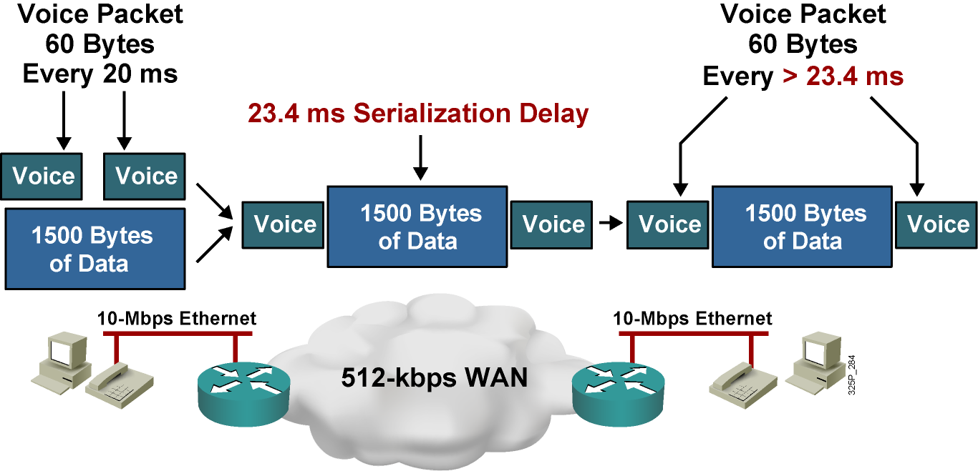
Large Packets “Freeze Out” Voice on Slow WAN Links
Problems:
Excessive delay due to slow link and MTU-sized (large) packets
Jitter (variable delay) due to variable link utilization
Notes:
In considering delay between two hops in a network, queuing delay in a router must be taken into account because it may be comparable to, or even exceed, serialization and propagation delay on a link. In an empty network, an interactive or voice session experiences low or no queuing delay, because the session does not compete with other applications on an interface output queue. Also, the small delay does not vary enough to produce significant jitter on the receiving side.
In a congested network, interactive data and voice applications compete in the router queue with other applications. Queuing mechanisms may prioritize voice traffic in the software queue, but the hardware queue (TxQ) always uses a FIFO scheduling mechanism. After packets of different applications leave the software queue, the packets will mix with other packets in the hardware queue, even if their software queue processing was expedited. Thus, a voice packet may be immediately sent to the hardware queue where two large FTP packets are waiting for transmission. The voice packet must wait until the FTP packets are transmitted, thus producing an unacceptable delay in the voice path. Because links are used variably, the delay varies with time and may produce unacceptable jitter in jitter-sensitive applications such as voice.
In the example shown here, the serialization delay of a 1500-byte packet over a 512-kbps link will be 24.3 ms. For VoIP traffic, the maximum recommended one-way, end-to-end delay is 150 ms. Therefore, having a 1500-byte packet ahead of a VoIP packet in the hardware queue on a 512-kbps link can cause the end-to-end delay of the voice packet to be over the budget of 24.3 ms.

Slide 29
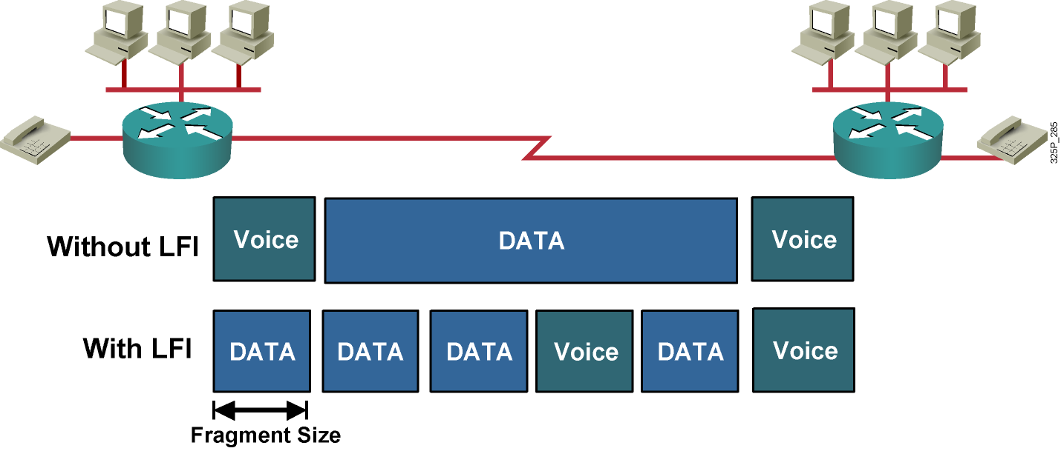
Link Fragmentation and Interleaving (LFI)
LFI reduces the delay and jitter of small packets (such as VoIP).
Notes:
The use of a hybrid queuing method such as low latency queuing (LLQ) can provide low latency and low jitter for VoIP packets while servicing other data packets in a fair manner. But, even if VoIP packets are always sent to the front of the software queue, there is still the issue of serialization delay. A large packet may be on its way out of the hardware queue, which uses FIFO. When a VoIP packet is sent to the front of the software queue, the serialization of the large packet in the hardware transmit queue can cause the VoIP packet to wait for a long time before it can be transmitted out.
The solution is to fragment the large packets so that they never cause a VoIP packet to wait for more than a predefined amount of time. The VoIP packets must also be allowed to transmit in between the fragments of the larger packets (interleaving), or there will be no point in doing the fragmenting.
When you are configuring the proper fragment size to use on a link, a typical goal is to have a maximum serialization delay of around 10 to 15 ms. Depending on the LFI mechanisms being configured, the fragment size is either configured in bytes or in milliseconds.

Slide 30
Applying Link Efficiency Mechanisms
Identify bottlenecks in the network.
Calculate Layer 2 and Layer 3 overhead.
Decide which type of compression to use, such as TCP header compression.
Enable compression on WAN interfaces.
Notes:
Use the following guidelines for applying link efficiency mechanisms:
Identify slow links to help determine where the bottlenecks in the network are located and decide how to apply link efficiency mechanisms at the appropriate interfaces.
Calculate the Layer 2 and Layer 3 overhead for each media type that will transport the business-critical traffic. This process will help you choose the correct compression type.
Decide which type of compression should be used.
Enable compression on the WAN interfaces.

Slide 31
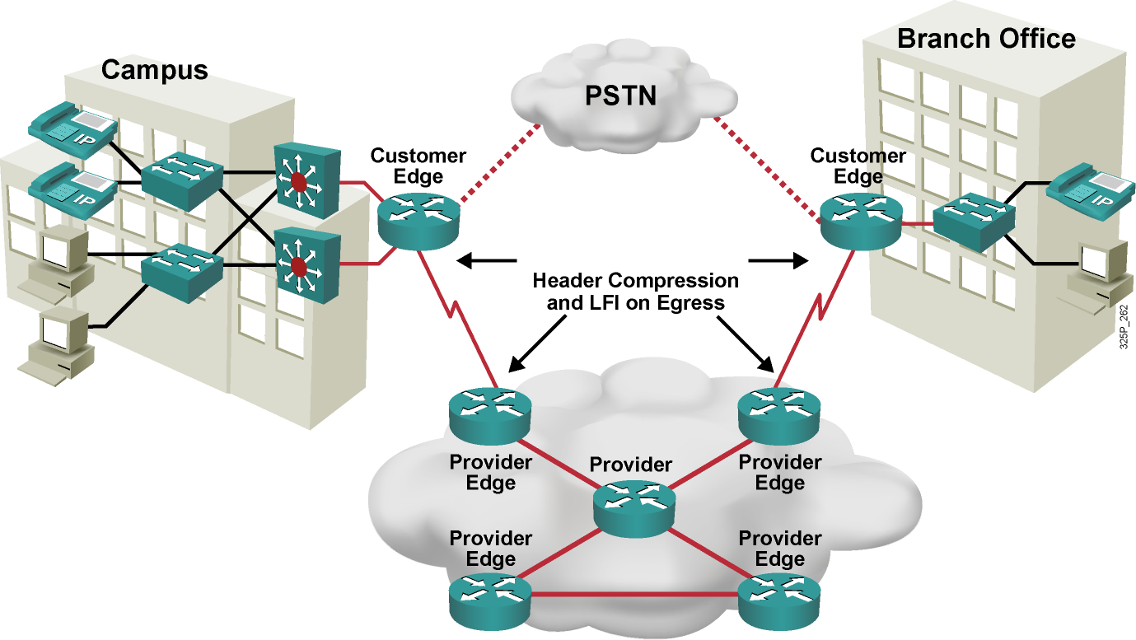
Network Using LFI
Notes:
This graphic shows an example of a network using LFI.
Header compression and LFI are typically configured at the WAN edge for WAN links below T1 or E1 speeds to optimize the use of the WAN link and to prevent long serialization delay.
Layer 2 payload compression is less commonly deployed on WAN links, especially without the use of hardware-assisted payload compression. In this case, use TCP and RTP compression, as well as LFI mechanisms, because this network carries converged network traffic.

Slide 32
Module 4: Implement the DiffServ QoS Model
Lesson 4.9: Implementing QoS Preclassify

Slide 33
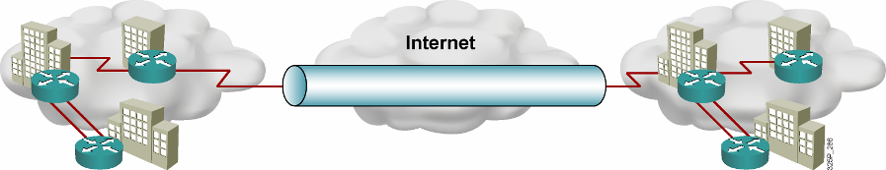
Virtual Private Networks
A VPN carries private traffic over a public network using advanced encryption and tunnels to protect:
Confidentiality of information
Integrity of data
Authentication of users
VPN Types:
Remote access:
Client-initiated
Network access server
Site-to-site:
Intranet
Extranet
Notes:
A virtual private network (VPN) is defined as network connectivity deployed on a shared (public) infrastructure with the same policies and security as a private network.
A VPN is established between two end systems or between two or more networks. A VPN can be built using tunnels, encryption, or both, at essentially any layer of the Open System Interconnection (OSI) protocol stack. A VPN is an alternative WAN infrastructure that replaces or augments private networks that use leased-line or enterprise-owned Frame Relay networks.
VPNs provide three critical functions:
Confidentiality (encryption): The sender can encrypt the packets before transmitting them across a network, prohibiting anyone from eavesdropping on the communication. If intercepted, the communication cannot be read.
Data integrity: The receiver can verify that the data was transmitted through the Internet without being changed or altered in any way.
Origin authentication: The receiver can authenticate the source of the packet, guaranteeing and certifying the source of the information.
There are two types of remote-access VPNs:
Client-initiated: Remote users use clients to establish a secure tunnel across an Internet service provider (ISP)-shared network to the enterprise.
Network access server (NAS)-initiated: Remote users dial in to an ISP. The NAS establishes a secure tunnel to the enterprise private network that might support multiple remote user-initiated sessions.
Site-to-site VPNs include two main types:
Intranet VPNs: Connect corporate headquarters, remote offices, and branch offices over a public infrastructure
Extranet VPNs: Link customers, suppliers, partners, or communities of interest to a corporate intranet over a public infrastructure

Slide 34
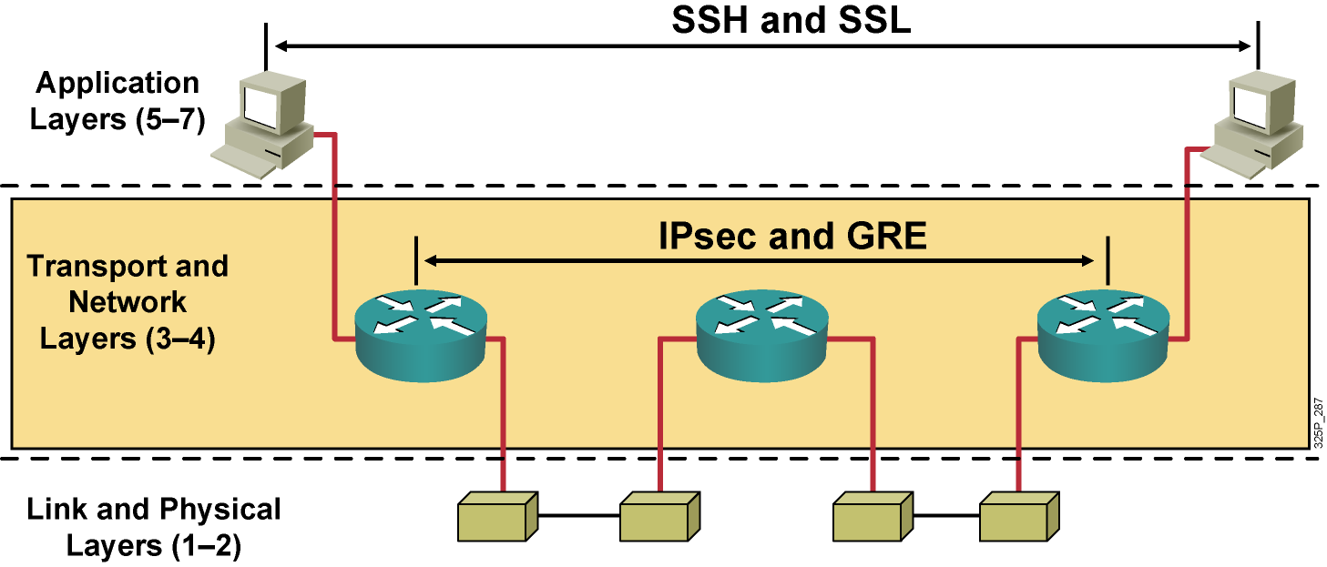
Encryption Overview
Notes:
Various methods for VPN protection are implemented on different layers. Providing privacy and other cryptographic services at the application layer was very popular in the past, and in some situations is still done today. For example, Secure Shell Protocol (SSH) offers Internet-based data-security technologies and solutions, especially for cryptography and authentication products.
However, application-layer security is application-specific, and protection methods must be implemented anew in every application.
Some standardization has been successful at Layer 4 (transport) of the OSI model, with protocols such as Secure Socket Layer (SSL) providing privacy, authenticity, and integrity to TCP-based applications. SSL is popular in modern e-commerce sites, but it fails to address the issues of flexibility, ease of implementation, and application independence.
Protection at lower levels of the OSI stack, especially the data link layer, was also used in early communication systems, because it provides protocol-independent protection on specific untrusted links. However, data link layer protection is expensive to deploy on a large scale (protecting every link separately), potentially allowing man-in-the-middle attacks (the hijacking of a network session) on intermediate stations (routers).
Because of these limitations, Layer 3 has become the most popular level on which to apply cryptographic protection to network traffic.

Slide 35
VPN Protocols
Protocol | Description | Standard
L2TP | Layer 2 Tunneling Protocol | Based on Cisco Layer 2 Forwarding (L2F) and Microsoft's Point-to-Point Tunneling Protocol (PPTP), RFC 3631
GRE | Generic Routing Encapsulation | RFC 1701, RFC 1702, RFC 2748
IPsec | Internet Protocol Security | RFC 4301
Notes:
The table describes three VPN tunneling protocols: Layer 2 Tunneling Protocol (L2TP), generic routing encapsulation (GRE), and IPsec:
L2TP: L2TP acts like a data link layer (layer 2 of the OSI model) protocol for tunneling network traffic between two peers over an existing network (usually the Internet). L2TP is in fact a Layer 5 protocol session layer, and uses the registered UDP port 1701. The entire L2TP packet, including payload and L2TP header, is sent within a UDP datagram.
GRE: This multiprotocol transport encapsulates IP and any other protocol packets inside IP tunnels. With GRE tunneling, a Cisco router at each site encapsulates protocol-specific packets in an IP header, creating a virtual point-to-point link to Cisco routers at other ends of an IP cloud where the additional IP header is stripped off. GRE does not provide encryption and can be monitored with a protocol analyzer.
IPsec: IPsec is the choice for secure corporate VPNs. IPsec is a framework of open standards that provides data confidentiality, data integrity, and data authentication between participating peers. IPsec provides security services to handle negotiation of protocols and algorithms based on local policy and to generate encryption and authentication keys.

Slide 36
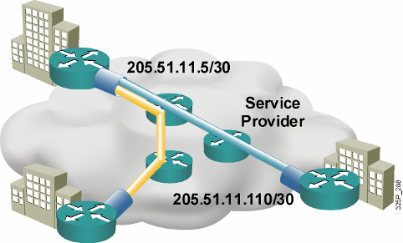
QoS Preclassify
VPNs are growing in popularity.
The need to classify traffic within a traffic tunnel is also gaining importance.
QoS preclassify is a Cisco IOS feature that allows packets to be classified before tunneling and encryption occur.
Preclassification allows traffic flows to be adjusted in congested environments.
Notes:
Quality of service (QoS) preclassify is designed for tunnel interfaces. When the feature is enabled, the QoS features on the output interface classify packets before encryption, allowing traffic flows to be managed in congested environments. The result is more effective packet tunneling.
The QoS preclassify feature provides a solution for making Cisco IOS QoS services operate in conjunction with tunneling and encryption on an interface. Cisco IOS software can classify packets and apply the appropriate QoS service before data is encrypted and tunneled. This allows service providers and enterprises to treat voice, video, and mission-critical traffic with a higher priority across service provider networks while using VPNs for secure transport.

Slide 37
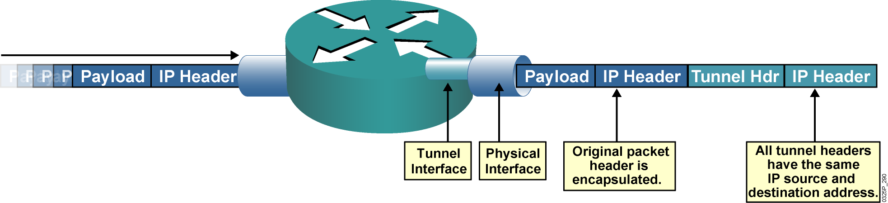
QoS Preclassify Applications
When packets are encapsulated by tunnel or encryption headers, QoS features are unable to examine the original packet headers and correctly classify packets.
Packets traveling across the same tunnel have the same tunnel headers, so the packets are treated identically if the physical interface is congested.
Notes:
When packets are encapsulated by a tunneling or encryption protocol, the original packet header is no longer available for examination. From the QoS perspective, providing differentiated levels of service is extremely difficult without the ability to examine the original packet header. The QoS markers normally found in the header of the IP packet must also be visible in the tunnel packet header, regardless of the type of tunnel in use.
IPsec and GRE are the two primary tunneling protocols relevant to VPNs.

Slide 38
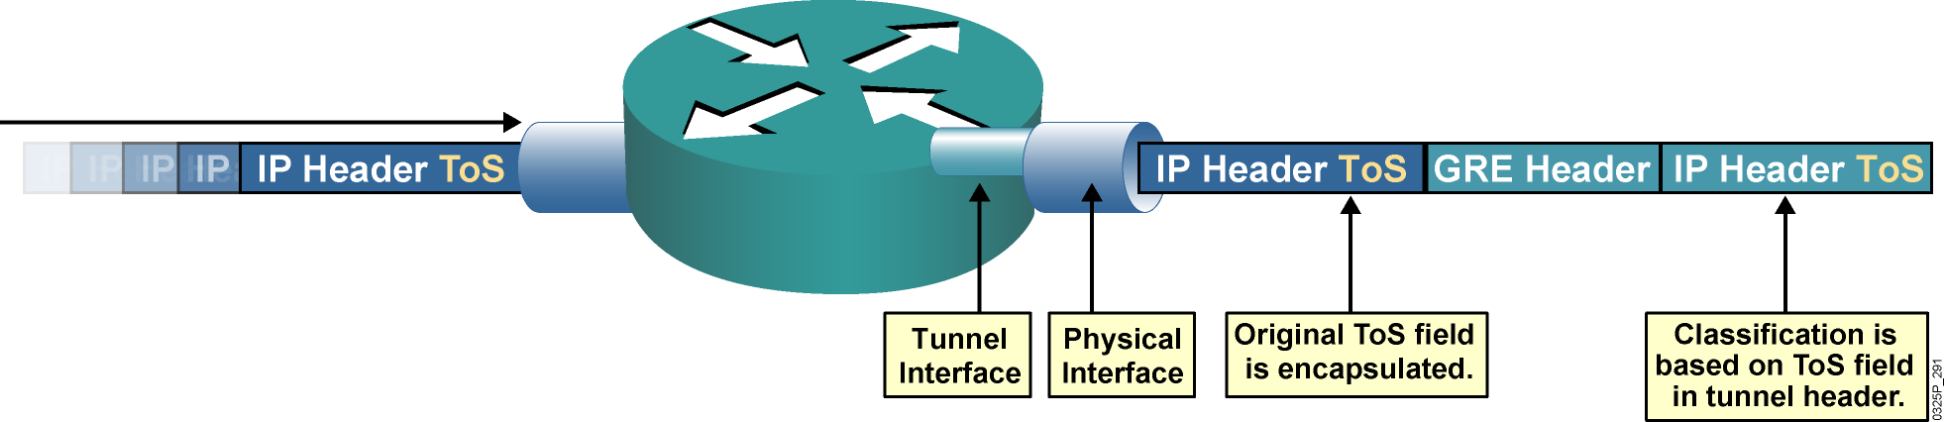
GRE Tunneling
ToS classification of encapsulated packets is based on the tunnel header.
By default, the ToS field of the original packet header is copied to the ToS field of the GRE tunnel header.
GRE tunnels commonly are used to provide dynamic routing resilience over IPsec, adding a second layer of encapsulation.
Notes:
Cisco offers support for encapsulation of data using either IPsec or GRE. GRE tunnels allow any protocol to be tunneled in an IP packet. In either of these scenarios, Cisco IOS software defaults to copying the IP type of service (ToS) values from the packet header into the tunnel header. This feature allows the ToS bits to be copied to the tunnel header when the router encapsulates the packets.
GRE tunneling allows routers between GRE-based tunnel endpoints to see the packet marking, improving the routing of premium service packets. Cisco IOS QoS technologies such as policy routing, weighted fair queuing (WFQ), and weighted random early detection (WRED) can operate on intermediate routers between GRE tunnel endpoints.
GRE tunnels are commonly used to provide dynamic routing resilience over IPsec. Normal IPsec configurations cannot transfer routing protocols, such as Enhanced Interior Gateway Routing Protocol (EIGRP) and Open Shortest Path First (OSPF), or non-IP traffic, such as Internetwork Packet Exchange (IPX) and AppleTalk.

Slide 39
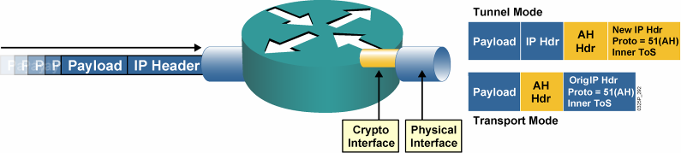
IPsec AH
IPsec AH is for authentication only and does not perform encryption.
With tunnel mode, the ToS byte value is copied automatically from the original IP header to the tunnel header.
With transport mode, the original header is used, and therefore the ToS byte is accessible.
Notes:
IPsec does not define the specific security algorithms to use; rather, IPsec provides an open framework for implementing industry-standard algorithms.
Authentication Header (AH), a key protocol in the IPsec (Internet Security) architecture, provides connectionless integrity and data origin authentication for IP datagrams, and provides protection against replays. AH can also provide nonrepudiation.
The Internet Assigned Numbers Authority (IANA) has assigned protocol number 51 to AH. Thus, in the presence of an AH header with both tunnel mode and transport mode, the IP header uses a value of 51 in the protocol field.
This graphic illustrates how the ToS is used with the AH protocol.
IPsec AH may be applied alone, in combination with the IP Encapsulating Security Payload (ESP), or in a nested fashion by using tunnel mode. With tunnel mode, the ToS byte value is copied automatically from the original IP header to the tunnel header.

Slide 40
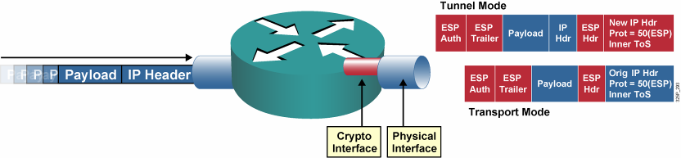
IPsec ESP
IPsec ESP supports both authentication and encryption.
IPsec ESP consists of an unencrypted header followed by encrypted data and an encrypted trailer.
With tunnel mode, the ToS byte value is copied automatically from the original IP header to the tunnel header.
Notes:
Encapsulating Security Payload (ESP) is a key protocol in the IPsec architecture, designed to provide a mix of security services in IPv4 and IPv6. ESP can provide both encryption and authentication. ESP seeks to provide confidentiality and integrity by encrypting data to be protected and placing the encrypted data in the data portion of the ESP. Depending on the user's security requirements, this mechanism may be used to encrypt either a transport-layer segment (e.g., TCP, UDP, ICMP, IGMP) or an entire IP datagram. Encapsulating the protected data is necessary to provide confidentiality for the entire original datagram.
As with AH, ESP supports SHA and MD5 hash algorithms for authentication. ESP supports Data Encryption Standard (DES) and Triple-DES (3DES) encryption protocols. The ESP header is at least 8 bytes. The Internet Assigned Numbers Authority (IANA) has assigned protocol number 50 to ESP.
With tunnel mode, the ToS byte value is copied automatically from the original IP header to the tunnel header.

Slide 41
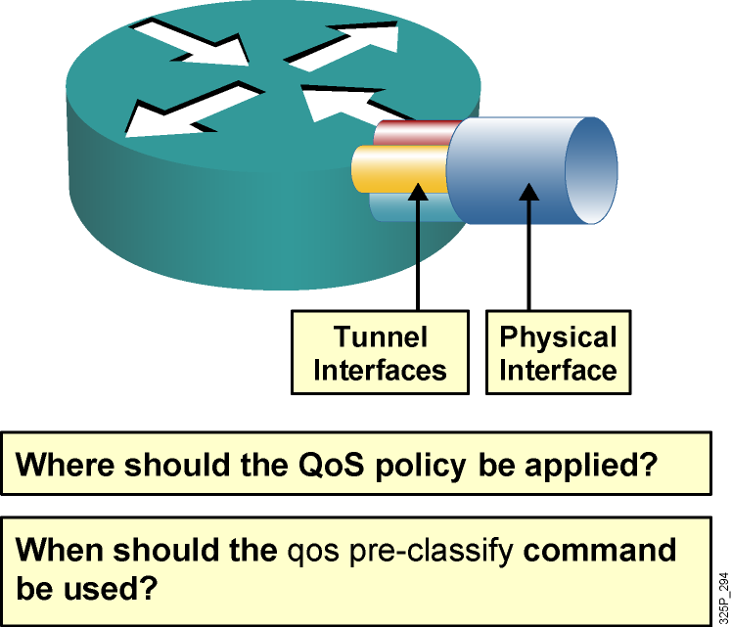
QoS Preclassification Deployment Options
Tunnel interfaces support many of the same QoS features as physical interfaces.
In VPN environments, a QoS service policy can be applied to the tunnel interface or to the underlying physical interface.
The decision about whether to configure the qos preclassify command depends on which header is used for classification.
Notes:
Classification defines the process of matching one or more fields in a packet header at Layer 2, 3, or 4 and then placing that packet in a group or class of traffic. Using packet classification, network traffic can be partitioned into multiple priority levels or classes of service.
When configuring IPsec with GRE, the simplest classification approach is to match on IP precedence or differentiated services code point (DSCP) values. In addition, with the ToS byte preservation feature, the router automatically copies the ToS header value from the original IP packet to the encapsulating IP header when using IPsec in tunnel mode.
ToS byte preservation also applies to AH. ESP in transport mode retains the original IP header, and the original ToS value is transmitted even without ToS byte preservation. If packets arrive at the router without set IP precedence or DSCP values, class-based marking is used to re-mark the packet headers before encryption or encapsulation. When the packets reach the egress interface, the QoS output policy can match and act on the re‑marked values.
Alternatively, traffic may need to be classified based on values other than IP precedence or DSCP. For example, packets may need to be classified based on IP flow or Layer 3 information, such as source and destination IP address. To do so, use the QoS for VPNs feature enabled with the qos pre-classify command.

Slide 42
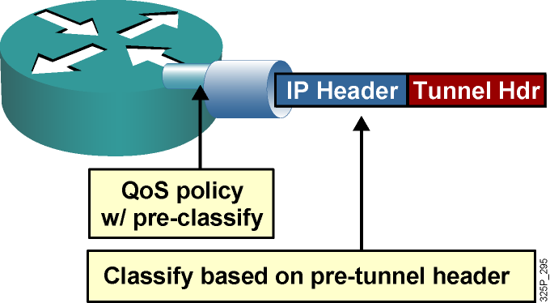
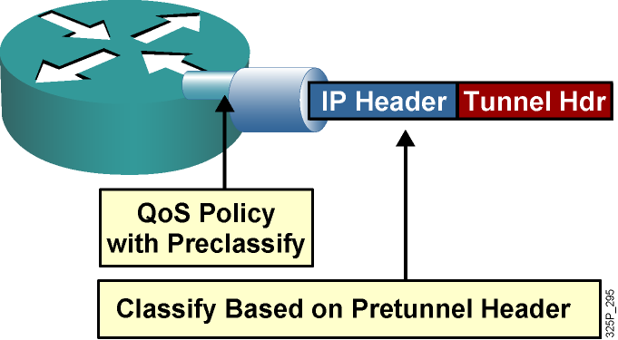
QoS Preclassification IPsec and GRE Configuration
QoS preclassify allows access to the original IP header values.
QoS preclassify is not required if classification is based on the original ToS values since the ToS value is copied by default to a new header.
IPsec and GRE configuration:
!
crypto map static-crypt 1 ipsec-isakmp
qos pre-classify
set peer ….etc
!
interface Tunnel 0
etc..
qos pre-classify
crypto map static-crypt
!
interface Ethernet 0/1
service-policy output minbwtos
crypto map static-crypt
!
Note: ToS byte copying is done by the tunneling mechanism and NOT by the qos pre-classify command.
Notes:
The qos pre-classify command mechanism allows Cisco routers to make a copy of the inner IP header and to run a QoS classification before encryption, based on fields in the inner IP header.
If the classification policy matches on the ToS byte, it is not necessary to use the qos pre-classify command, because the ToS value is copied to the outer header by default. In addition, a simple QoS policy that sorts traffic into classes based on IP precedence can be created. However, differentiating traffic within a class and separating it into multiple flow-based queues requires the qos pre-classify command.
You can apply a service policy to either the tunnel interface or to the underlying physical interface. The decision about where to apply the policy depends on the QoS objectives and on which header you need to use for classification, as follows:
Apply the policy to the tunnel interface without qos pre-classify when you want to classify packets based on the pretunnel header.
Apply the policy to the physical interface without qos pre-classify when you want to classify packets based on the post-tunnel header. In addition, apply the policy to the physical interface when you want to shape or police all traffic belonging to a tunnel and the physical interface supports several tunnels.
Apply the policy to an interface and enable qos pre-classify when you want to classify packets based on the pretunnel header.

Slide 43
Configuring QoS Preclassify
router(config-if)#
qos pre-classify
Enables the QoS preclassification feature.
This command is restricted to tunnel interfaces, virtual templates, and crypto maps.
GRE Tunnels
router(config)# interface tunnel0
router(config-if)# qos pre-classify
IPSec Tunnels
router(config)# crypto map secured-partner
router(config-crypto-map)# qos pre-classify
Notes:
This graphic shows the command syntax
The qos pre-classify Cisco IOS command enables the QoS preclassification feature.
The qos pre-classify command can be applied to a tunnel interface, a virtual template interface, or a crypto map.

Slide 44
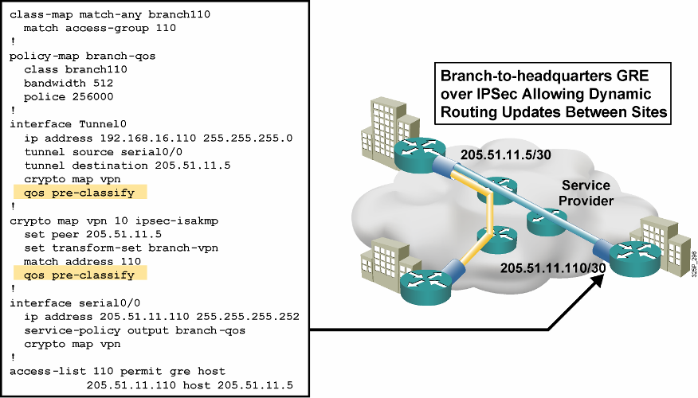
QoS Preclassify: Example
Notes:
This example shows the configuration of the qos pre-classify command.
On the serial0/0 interface on the branch router, there is an outgoing service policy that sets the bandwidth of the interface at 256 kbps and policing at a rate of 512 kbps. This policy is applied to any match in the class map branch 110.
A traffic tunnel has been built on interface serial0/0 (whose destination is the headquarters for this branch). It is on this traffic tunnel that QoS preclassification has been configured.
The example configuration also shows that QoS preclassify has been successfully enabled on the crypto map named “vpn.” This crypto map has also been applied to serial0/0. If QoS preclassify is enabled only on the crypto map and not on the tunnel interface, the router will see one flow only, the GRE tunnel (protocol 47), rather than the multiple flows requiring the benefits of QoS which are “within” the GRE tunnel.

Slide 45
Module 4: Implement the DiffServ QoS Model
Lesson 4.10: Deploying End-to-End QoS

Slide 46
QoS SLAs
QoS SLAs provide contractual assurance for meeting the traffic QoS requirements.
Two major activities:
negotiate the agreement
verify compliance
QoS SLAs typically provide contractual assurance for parameters such as:
Delay (fixed and variable)
Jitter
Packet loss
Throughput
Availability
Notes:
A service level agreement (SLA) stipulates the delivery and pricing of service levels and spells out penalties for shortfalls. SLAs can cover an assortment of data services, such as Frame Relay, leased lines, Internet access, web hosting, and so on. The best way to understand an SLA is to break it into two activities:
Negotiating the technology agreement
Verifying compliance with the agreement
A quality of service (QoS) SLA typically provides contractual assurance for parameters such as delay, jitter, packet loss, throughput, and availability.
With the rapid growth of new multimedia real-time applications such as IP telephony, web conferencing, and e-learning, IP QoS SLAs are becoming increasingly important for enterprise networks.

Slide 47
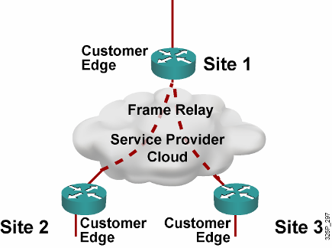
Enterprise Network with Traditional Layer 2 Service—No QoS
SP sells the customer a Layer 2 service.
SP provides point-to-point SLA from the SP.
But, the enterprise WAN is likely to get congested.
IP QoS is required for voice, video, data integration.
This SP is not involved in IP QoS, so ….
Notes:
This graphic illustrates an example in which a SP may provide only Layer 2 services to the enterprise customer.
The Customer Edge routers at the various customer sites are interconnected by Frame Relay virtual circuits (VCs). These VCs can be fully meshed, partially meshed, or set up as hub and spokes, depending on the customer requirements.
In this environment, the SP is responsible only for the end-to-end Layer 2 VC connections. The SP provides only a point-to-point SLA guarantee for each VC connection and is not involved with providing IP QoS to the customer.
To provide IP QoS for voice, video, and data integration over Frame Relay VCs, the customer must configure the proper QoS mechanisms, such as traffic shaping, low latency queuing (LLQ), FRF.12, and compressed Real-Time Transport Protocol (cRTP) at the WAN Customer Edge routers, because the Frame Relay WAN link is likely to become congested.

Slide 48
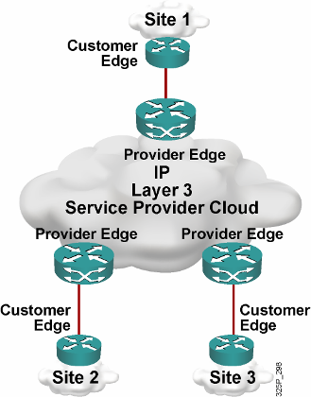
Enterprise Network with IP Service
Customer buys Layer 3 service from a different SP.
There is a point-to-cloud SLA from SP for conforming traffic.
Enterprise WAN is still likely to get congested.
But, this time the SP is involved in IP QoS.
Notes:
In this second example, another SP offers Layer 3 services to the enterprise customer. The Customer Edge routers at the various customer sites connect to the Provider Edge of the SP router. From a particular customer site perspective, every IP address that is not located on-site is reachable via the SP IP backbone network.
In this environment, the SP can provide value-added IP services to the customer by providing SLAs for the conforming traffic from the customer. An SLA can, for example, divide customer traffic at the network edge into controlled latency, controlled load 1, and controlled load 2 classes and then provide IP QoS assurances to each traffic class conforming to the contractual rate over a Differentiated Services (DiffServ) IP backbone. For all nonconforming (exceeding) traffic, the SP can re-mark and deliver all nonconforming traffic with best-effort service.

Slide 49
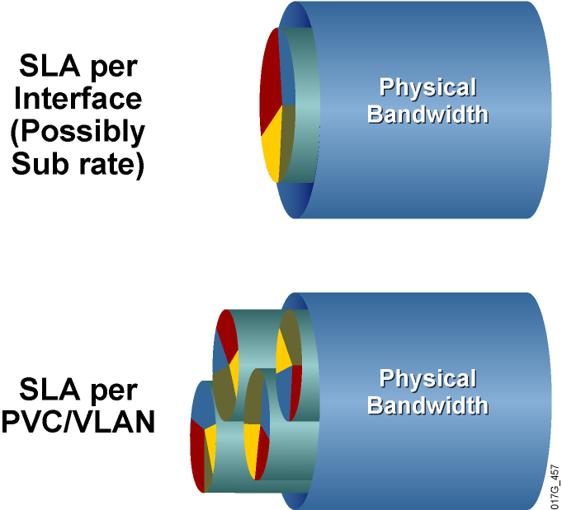
SLA Structure
SLA typically includes between three and five classes.
Real-time traffic gets fixed bandwidth allocation.
Data traffic gets variable bandwidth allocation with minimum guarantee.
Notes:
The typical IP QoS SLA offered by most SPs often includes three to five traffic classes; for example, a real-time traffic class, a mission-critical data traffic class, one or two other data traffic classes, and a best-effort traffic class.
The SLA for the real-time traffic class should be guaranteed a fixed maximum bandwidth, while the data traffic classes should be guaranteed a minimum bandwidth. Typically, the bandwidth allocation is configured as a percentage of the interface bandwidth. Each traffic class can also have a latency, delay, jitter, and packet-loss guarantee.
Between the Customer Edge and Provider Edge, there may be additional traffic classes that are used by the SPs only. For example, there may be a management traffic class for traffic such as Telnet or Simple Network Management Protocol (SNMP) from the SP to the SP-managed Customer Edge routers.
If a single physical interface is serving only one customer, the SLA is typically set up per interface. To provide easy bandwidth upgrades, SPs often install a high-speed link to the customer and then offer a subrate access.
If a single physical interface is serving many different customers, the SLA is typically set up per permanent virtual circuit (PVC) or per VLAN.

Slide 50
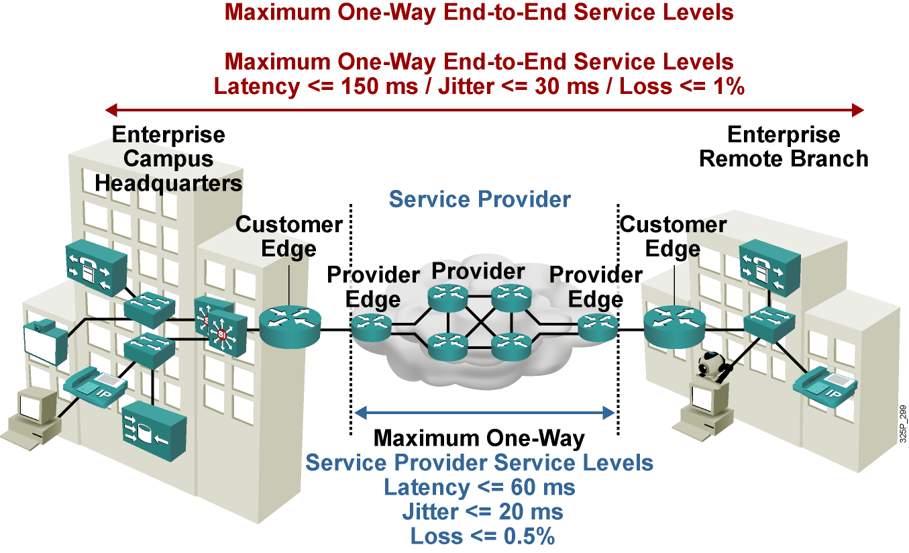
Typical SLA Requirements for Voice
Notes:
To meet the QoS requirements for the different traffic types, both the enterprise and the SP must implement the proper QoS mechanisms to provide end-to-end QoS for the packets traversing an SP IP network.
In this example, the enterprise headquarters and the enterprise branch office are connected to a SP that is providing Layer 3 services.
The SP is providing an SLA for voice traffic with a latency of 60 ms or less, jitter of 20 ms or less, and packet loss of 0.5 percent or less. To meet the end-to-end QoS requirements for voice packets, the entire enterprise network must contribute less than 90 ms of delay—that is, 90 ms (enterprise network) + 60 ms (SP network) <= 150 ms total one-way delay.
Similarly, the jitter in the enterprise network must be less than 10 ms—that is, 10 ms + 20 ms <= 30 ms total one-way jitter.
Finally, packet loss within the enterprise network must be less than 0.5 percent—that is, 0.5 percent + 0.5 percent <= 1.0 percent total packet loss.

Slide 51
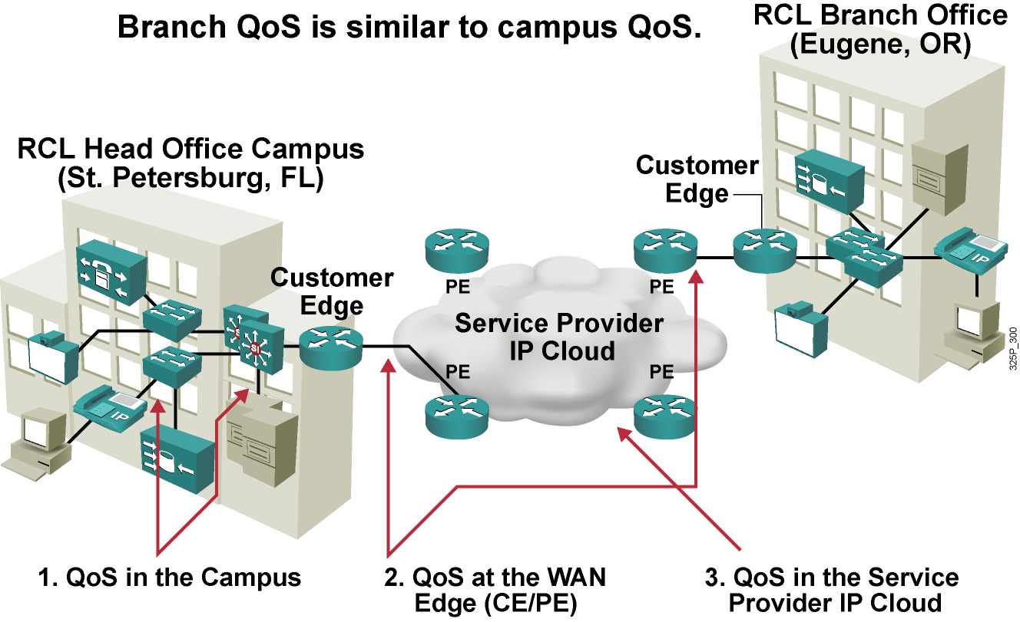
Deploying End-to-End QoS
Notes:
To meet the QoS requirements for different traffic types, both enterprise and SP must implement the proper IP QoS mechanisms to provide end-to-end QoS for the packets traversing a SP network.
This means that at both customer locations, traffic classifications and marking need to be performed (for example, VoIP, data). Depending on the customer connection to the SP, these markings can be mapped into Multiprotocol Label Switching (MPLS) Experimental (EXP) bits, for example, and given priorities. The provider now must guarantee correct transfer over the core to the branch office. The traffic arrives there with the same markings that were set at the head office, allowing again the classification that is needed for end-to-end QoS.

Slide 52
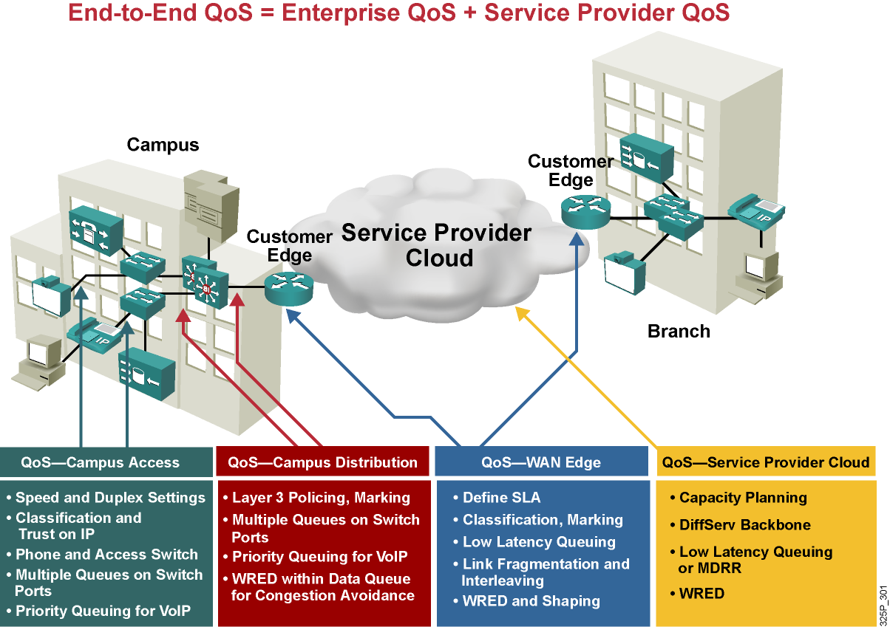
End-to-End QoS Requirements
Notes:
This graphic lists some of the requirements within the building blocks that constitute the end-to-end network.
QoS at the campus access layer focuses on speed and duplex settings, classification, hardware requirements, and queuing.
QoS at the campus distribution layer deals with policing, marking, and congestion avoidance.
Complex QoS configurations typically occur at the WAN edge.
In the IP core (SP cloud), only congestion-management and congestion-avoidance mechanisms are in operation. Key QoS mechanisms used in an IP core include LLQ and weighted random early detection (WRED).

Slide 53
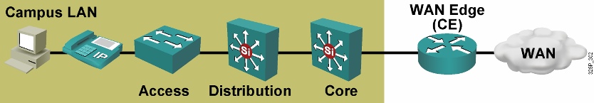
General Guidelines for Campus QoS
Multiple queues are required on all interfaces to prevent transmit queue congestion and drops.
Voice traffic should always go into the highest-priority queue.
Trust the Cisco IP phone CoS setting but not the PC CoS setting.
Classify and mark traffic as close to the source as possible.
Use class-based policing to rate-limit certain unwanted excess traffic.
Notes:
Some of the general guidelines to follow when implementing campus QoS include the following:
Classify and mark the traffic as soon as possible: This principle promotes end-to-end DiffServ PHBs. Sometimes endpoints can be trusted to set class of service (CoS) and differentiated services code point (DSCP) markings correctly, but this practice is not recommended because users can easily abuse provisioned QoS policies if they are permitted to mark their own traffic. For example, if DSCP Expedited Forwarding (EF) receives priority services throughout the enterprise, a user could easily configure the network interface card (NIC) on a PC to mark all traffic to DSCP EF, thus hijacking network priority queues to service non-real-time traffic. Such abuse could easily ruin the service quality of real-time applications (such as VoIP) throughout the enterprise.
Police unwanted traffic flows as close to their sources as possible: There is little sense in forwarding unwanted traffic only to police and drop it at a subsequent node. This is especially the case when the unwanted traffic is the result of denial-of-service (DoS) or worm attacks. Such attacks can cause network outages by overwhelming network device processors with traffic.
Always perform QoS in hardware rather than software when a choice exists: Cisco IOS routers perform QoS in software. This design places additional demands on the CPU, depending on the complexity and functionality of the policy. Cisco Catalyst switches, on the other hand, perform QoS in dedicated hardware ASICs, which does not tax their main CPUs in administering QoS policies. You can therefore apply complex QoS policies at Gigabit and 10 Gigabit Ethernet line speeds in these switches.
Establish proper trust boundaries: For example, at the access layer switches, trust only the IP Phone CoS marking, not the PC CoS marking.
Classify real-time voice and video as higher-priority traffic: Real-time voice and video traffic must be classified at a higher priority than data traffic.
Use multiple queues on the transmit interfaces: Use multiple queues on the transmit interfaces to minimize the potential for dropped or delayed traffic caused by transmit buffer congestion.

Slide 54
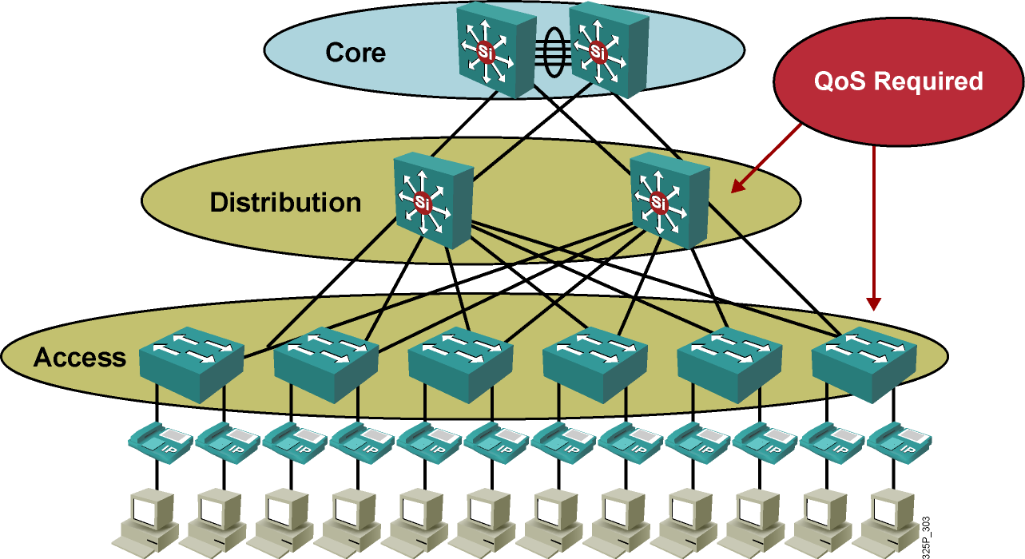
Campus Access and Distribution Layer QoS Implementation
Notes:
It is quite rare under normal operating conditions for campus networks to suffer congestion. If congestion does occur, it is usually momentary and not sustained, as at a WAN edge. However, critical applications like VoIP require service guarantees regardless of network conditions.
The only way to provide service guarantees is to enable queuing at any node that has the potential for congestion—regardless of how rarely, in fact, congestion may occur. The potential for congestion exists in campus uplinks because of oversubscription ratios and speed mismatches in campus downlinks (for example, Gigabit Ethernet to Fast Ethernet links). The only way to provision service guarantees in these cases is to enable queuing at these points.
Queuing helps to meet network requirements under normal operating conditions, but enabling QoS within the campus is even more critical under abnormal network conditions, such as DoS and worm attacks. During such conditions, network traffic may increase exponentially until links are fully used. Without QoS, the worm-generated traffic drowns out applications and causes denial of service through unavailability. Enabling QoS policies maintains network availability by protecting and servicing critical applications, such as VoIP, and even best-effort traffic.
So where is QoS required in campus?
Access switches use the following QoS features:
Classification on a per-packet basis
Policing and/or shaping
Fragmentation
Compression
Congestion management
Congestion avoidance
Distribution and core switches use the following QoS features:
Classification on a per-packet basis
Marking
Congestion management
Congestion avoidance
Congestion management
Congestion avoidance

Slide 55
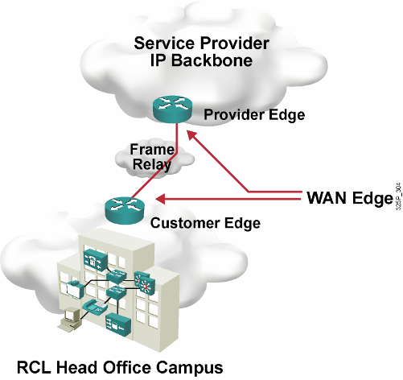
WAN Edge QoS Implementation
Notes:
Routers that terminate the WAN link between the Customer Edge (CE) and the Provider Edge (PE) require a significant configuration effort from the network administrators.
Looking at this figure reveals that administrators need to enable and tune several WAN technologies, such as Frame Relay and ATM, and QoS features, such as LLQ, traffic shaping, and compression, to provide a high level of QoS.

Slide 56
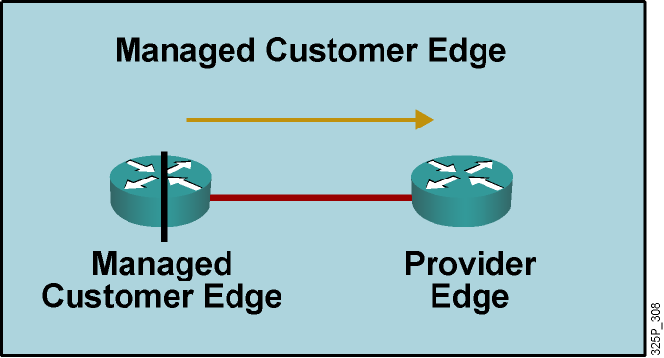
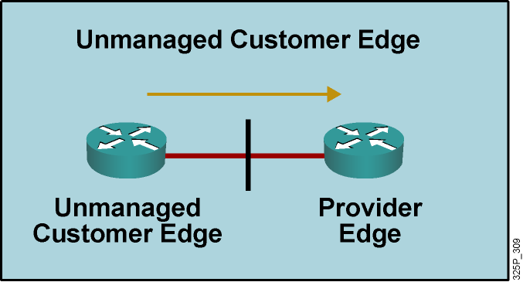
CE and PE Router Requirements for Traffic Leaving Enterprise Network
Output QoS policy on Customer Edge controlled by service provider.
Service provider enforces SLA using the output QoS policy on Customer Edge.
Output policy uses queuing, dropping, and possibly shaping.
Elaborate traffic classification or mapping of existing markings.
May require LFI or cRTP.
Output QoS policy on Customer Edge not controlled by service provider.
Service provider enforces SLA using input QoS policy on Provider Edge.
Input policy uses policing and marking.
Elaborate traffic classification or mapping of existing markings on Provider Edge.
Notes:
First, consider traffic leaving the enterprise network. The QoS requirements on the Customer Edge and Provider Edge routers will differ, depending on whether the SP manages the Customer Edge. Consider two possibilities—a managed Customer Edge and an unmanaged Customer Edge.
For traffic leaving the enterprise Customer Edge router and moving toward the SP edge router, the general QoS requirements on the Customer Edge and Provider Edge routers are listed.
For managed Customer Edge service, the SP will manage and configure the WAN edge output QoS policy on the Customer Edge.
For unmanaged Customer Edge service, the enterprise customer will manage and configure the WAN edge output QoS policy on the Customer Edge.

Slide 57
SP QoS Responsibilities for Traffic Leaving Enterprise Network
Customer Edge Output Policy | Provider Edge Input Policy
Classification, Marking, and Mapping LLQ WRED [Shaping] [LFI or cRTP] | <Not required>
Customer Edge Output Policy | Provider Edge Input Policy
<Irrelevant> | Classification, Marking, and Mapping Policing
Notes:
This graphic shows the SP QoS responsibilities in each of the two scenarios.
For managed Customer Edge service, the SP can enforce the SLA for each traffic class using the output QoS policy on the Customer Edge. For example, you can use LLQ or class-based weighted fair queuing (CBWFQ) to give a maximum bandwidth guarantee to the real-time voice and video traffic class, give a minimum bandwidth guarantee to the data traffic class, and use class-based shaping to provide a maximum rate limit to each data traffic class.
For unmanaged Customer Edge service, because the SP has no control over the Customer Edge, the SP can enforce the SLA for each traffic class only at the input of the Provider Edge router. For example, you can use class-based policing to limit the input traffic rate of the different traffic classes and to re-mark the exceeding traffic.
For an unmanaged Customer Edge, the Customer Edge output policy is managed and configured by the enterprise customer; therefore, it is irrelevant to the SP. At the Provider Edge input interface, the SP has a policy to classify, mark, or map the traffic. The SP also typically implements traffic policing to limit the input traffic rate from the enterprise customer so that the traffic rate does not exceed the contractual rate specified in the SLA.
For a managed Customer Edge, the Customer Edge output policy is managed and configured by the SP. The SP typically has an output policy on the Customer Edge router to classify and mark the traffic exiting the Customer Edge router. LLQ or CBWFQ, along with WRED, are used for congestion management and congestion avoidance. To compensate for speed mismatch or oversubscription, traffic shaping may be required. To improve link efficiency, link fragmentation and interleaving (LFI) and cRTP are used for lower-speed links.

Slide 58
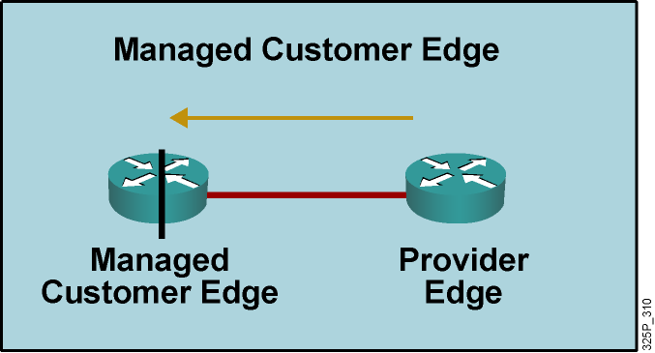
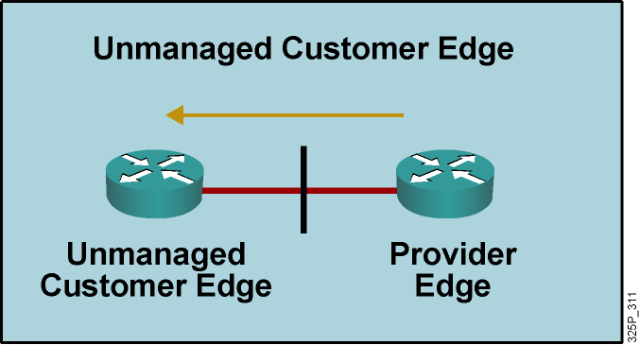
SP Router Requirements for Traffic Leaving SP Network
Service provider enforces SLA using the output QoS policy on Provider Edge.
Output policy uses queuing, dropping, and, optionally, shaping.
May require LFI or cRTP.
No input QoS policy on Customer Edge needed.
Service provider enforces SLA using the output QoS policy on Provider Edge.
Output policy uses queuing, dropping, and, optionally, shaping.
May require LFI or cRTP.
Input QoS policy on Customer Edge irrelevant.
Notes:
For traffic leaving the SP edge router toward the enterprise Customer Edge router, this graphic illustrates the general QoS requirements on the Customer Edge and Provider Edge routers.
For both managed and unmanaged Customer Edge service, the SP can enforce the SLA for each traffic class using the output QoS policy on the Provider Edge.
Queuing and compression can be enabled.
An input policy is not needed.

Slide 59
SP QoS Policies for Traffic Leaving SP Network
Customer Edge
Input Policy
<Not needed>
Provider Edge
Output Policy
LLQ
WRED
[Shaping]
[LFI or cRTP]
Customer Edge
Input Policy
<Irrelevant>
Provider Edge
Output Policy
LLQ
WRED
[Shaping]
[LFI or cRTP]
Notes:
For traffic leaving the SP edge router toward the enterprise Customer Edge router, this graphic illustrates the QoS mechanisms that are commonly implemented at the Provider Edge router.
For both managed and unmanaged Customer Edge service, the SP typically has an output policy on the Provider Edge router using LLQ or CBWFQ, along with WRED, for congestion management and congestion avoidance.
To compensate for speed mismatch or oversubscription, traffic shaping may be required.
To improve the link efficiency, LFI and cRTP are used for lower-speed links.

Slide 60
Managed Customer Edge with Three Service Classes
The service provider in this example is offering managed customer edge service with three service classes:
Real-time (VoIP, interactive video, call signaling): Maximum bandwidth guarantee, low latency, no loss
Critical data (routing, mission-critical data, transactional data, and network management): Minimum bandwidth guarantee, low loss
Best-effort: No guarantees (best effort)
Most DiffServ deployments use a proportional differentiation model:
Rather than allocate absolute bandwidths to each class, service provider adjusts relative bandwidth ratios between classes to achieve SLA differentiation.
Notes:
In this example, the SP is implementing an IP DiffServ backbone and is offering three traffic classes with different SLAs for each:
Real-time (VoIP, interactive video, call signaling): The real-time traffic class is intended for voice traffic, interactive video, and call signaling. This class has a maximum bandwidth limit, low latency, and no loss guarantee.
Critical data (routing, mission-critical data, transactional data, and network management): The critical data traffic class is intended for mission-critical traffic. This class has a minimum bandwidth and a low loss guarantee.
Best-effort: The default (best effort) traffic class is intended for all other traffic. This class has no guarantee.
When you are implementing LLQ or CBWFQ, specify the bandwidth guarantees in kilobits per second, in a percentage of the available bandwidth, or in a percentage of the remaining available bandwidth. Most DiffServ deployments use a proportional differentiation model with the bandwidth guarantees configured as a percentage instead of a fixed bandwidth in kilobits per second.
For example, with three traffic classes, divide the bandwidth allocation as follows:
The real-time (VoIP, interactive video, call signaling) class LLQ can have a maximum bandwidth guarantee of 35 percent of the link bandwidth.
The critical data (routing, mission-critical data, transactional data and network management) class can have a minimum bandwidth guarantee of 40 percent of the link bandwidth after the LLQ is serviced.
The best-effort (default) class can have a minimum bandwidth guarantee of whatever is left—in this case, 25 percent of the link bandwidth after the LLQ is serviced.

Slide 61
WAN Edge Design
Class | Parameters
Real-time (VoIP) | Packet marked EF class and sent to LLQ Maximum bandwidth = 35% of CIR, policed Excess dropped
Real-time (call-signaling) | VoIP signaling (5%) shares the LLQ with VoIP traffic
Critical Data | Allocated 40% of remaining bandwidth after LLQ has been serviced Exceeding or violating traffic re-marked WRED configured to optimize TCP throughput
Best-effort | Best-effort class sent to CBWFQ Allocated 23% of remaining bandwidth after LLQ has been serviced WRED configured to optimize TCP throughput
Scavenger | Best-effort class sent to CBWFQ Whatever is left = 2% of remaining bandwidth
Notes:
For the real-time traffic class, VoIP packets will be marked with EF and go into the LLQ with these parameters:
The LLQ will be policed and have a maximum bandwidth of 35 percent of the committed information rate (CIR).
All excess traffic will be dropped.
The call-signaling traffic (5 percent) will share the LLQ with the VoIP bearer traffic.
For the critical data traffic class, the packets will be marked with Assured Forwarding (AF) 31 and go into the CBWFQ with these class parameters:
The class will be policed and have a minimum bandwidth guarantee of 40 percent of the remaining available bandwidth.
All exceeding and violating traffic will be re-marked and then sent.
WRED will be used on this traffic class to optimize TCP throughput.
For the best-effort traffic class, the packets will be marked with class selector 0 (CS0) and go into the CBWFQ with these class parameters:
The class will be policed and have a minimum bandwidth guarantee of 23 percent of the remaining available bandwidth.
WRED will be used on this traffic class to optimize TCP throughput.
For the scavenger traffic class, the packets will be marked with CS1, with these class parameters:
The class is not policed and has a minimum bandwidth guarantee of 2 percent of the remaining available bandwidth.

Slide 62
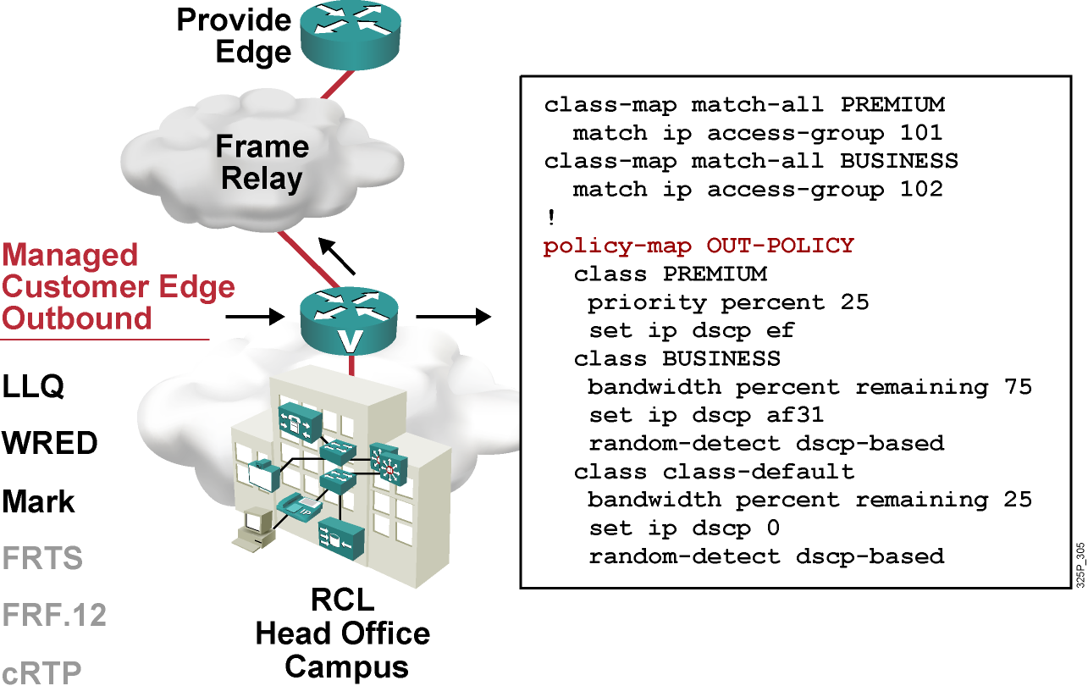
CE-to-PE QoS for Frame Relay Access CE Outbound
Provider Edge
Notes:
The traffic policy called “OUT-POLICY” is configured with three SP traffic classes to provide the LLQ or CBWFQ and WRED. Each traffic class bandwidth guarantee is configured using a percentage rather than a fixed bandwidth in kilobits per second.
Both the enterprise voice-bearer and voice-control traffic will be matched using access control list (ACL) 101 and will be serviced by the LLQ with a maximum bandwidth guarantee of 25 percent of the link bandwidth.
The enterprise mission-critical traffic will be matched using ACL 102 and have a minimum guaranteed bandwidth of 75 percent of the remaining available bandwidth after the LLQ has been serviced.
All other traffic from the enterprise will be classified into the default class and have a minimum guaranteed bandwidth of 25 percent of the remaining available bandwidth after the LLQ has been serviced.

Slide 63
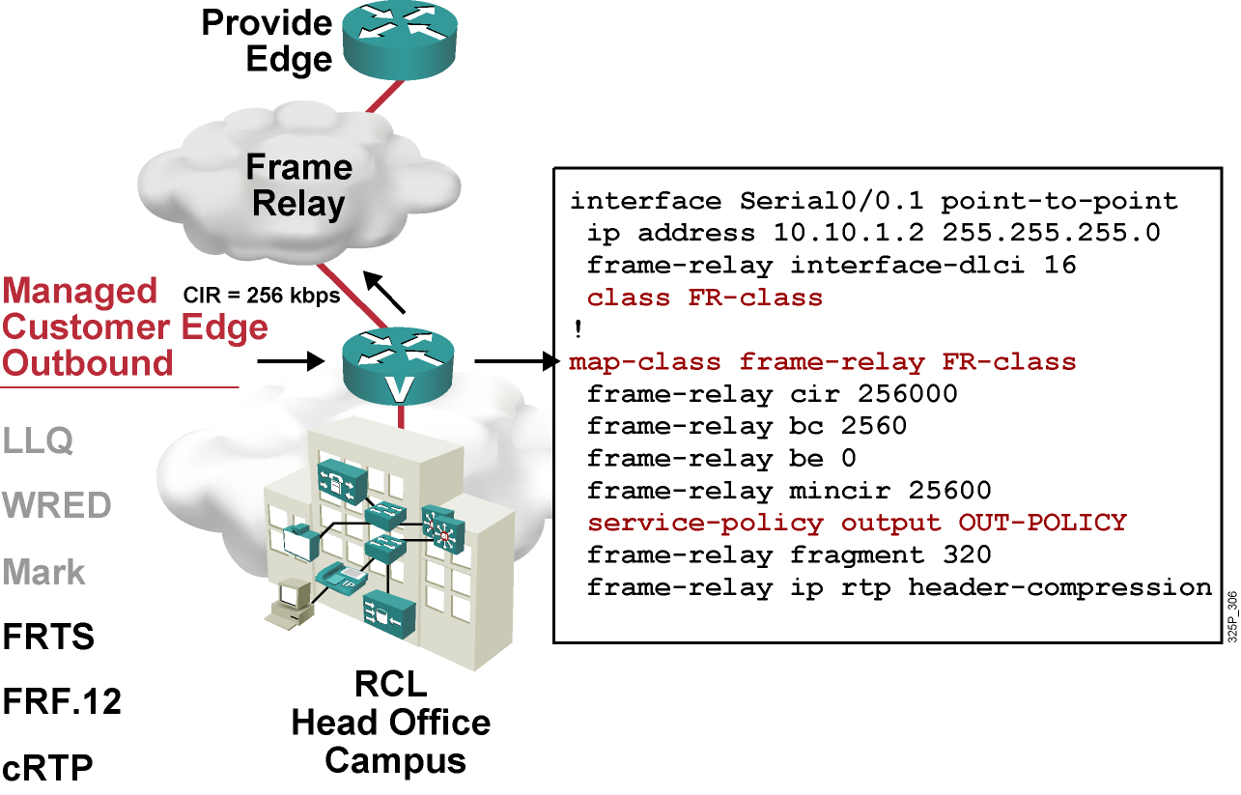
CE-to-PE QoS for Frame Relay Access CE Outbound Traffic Shaping
Provider Edge
Notes:
The topology shows that the Customer Edge and Provider Edge link is a Frame Relay link, and traffic shaping is implemented on the PVC using Frame Relay traffic shaping (FRTS).
FRTS is configured using a Frame Relay map class with a CIR of 256 kbps, a committed burst (Bc) of 2560 bits, an excess burst (Be) of 0 (no bursting), and a minimum CIR (mincir) of 256 kbps. The CIR is the rate at which you normally want to send when there is no congestion. The CIR needs to be the remote end-link speed or the actual CIR of the VC. The Bc is the amount that you will send per time interval. The CIR and Bc will be used to compute a committed time interval (Tc), where Tc = Bc / CIR. For FRTS, the command-line interface (CLI) will only allow Bc values that would result in a Tc that is between 10 ms and 125 ms. A recommended value for Tc is 10 ms.
To get a Tc of 10 ms, the Bc should be set to 1/100 of the CIR. The mincir parameter is required, because Cisco IOS software will only allow 75 percent of the mincir to be reserved by the QoS policy applied to the FRTS map class. If the mincir is not configured, it will default to 50 percent of the CIR, which is not desired.
FRF.12 fragmentation and interleaving and cRTP are also enabled within the Frame Relay map class. The fragment size in bytes is set to derive a maximum delay of 10 ms to 15 ms. The fragment size should be the same on both ends.
The OUT-POLICY traffic policy is applied within the Frame Relay map class.

Slide 64
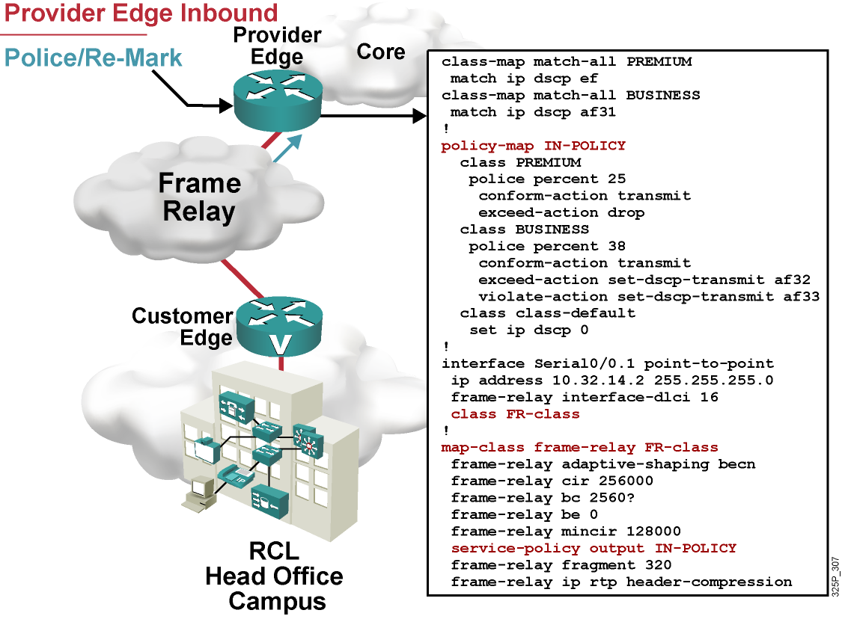
CE-to-PE QoS for Frame Relay Access PE Inbound
Notes:
The output shows the QoS configurations on the ingress
Provider Edge router inbound interface to implement the required QoS policy for each of the three SP traffic classes.
On the Provider Edge, a traffic policy called “IN-POLICY” is configured to provide the required class-based policing. For the premium class, the rate limit is set to 25 percent of the link bandwidth. All exceeding premium-class traffic is dropped. For the business class, the rate limit is set to 38 percent of the link bandwidth. All exceeding and violating business-class traffic is re-marked with a higher drop probability and then sent. The default class is not policed.
The IN-POLICY traffic policy is applied within the Frame Relay map class.

Slide 65
What Is CoPP?
The Control Plane Policing (CoPP) feature allows users to configure a QoS filter that manages the traffic flow of control plane packets to protect the control plane against DoS attacks.
CoPP has been available since Cisco IOS Software Release 12.2(18)S.
A Cisco router is divided into four functional planes:
Data plane
Management plane
Control plane
Service plane
Any service disruption to the route processor or the control and management planes can result in business-impacting network outages.
Notes:
Infrastructure attacks are becoming increasingly common, highlighting the need for infrastructure protection. The Control Plane Policing (CoPP) feature allows users to configure a QoS filter that manages the traffic flow of control plane packets to protect the control plane of Cisco IOS routers and switches against reconnaissance and DoS attacks. In this way, the control plane can help maintain packet forwarding and protocol states despite an attack or a heavy traffic load on the router or switch.
By protecting the Route Processor, CoPP helps ensure router and network stability during an attack. For this reason, a best-practice recommendation is to deploy CoPP as a key protection mechanism.
The CoPP feature was introduced in Cisco IOS Software Release 12.2(18)S.
A router has four functional components or planes:
Data plane
Management plane
Control plane
Services plane
The vast majority of traffic travels through the router via the data plane; however, the Route Processor must handle certain packets, such as routing updates, keepalives, and network management, referred to as control and management plane traffic.
Because the Route Processor is critical to network operations, any service disruption to the Route Processor or the control and management planes can result in business-impacting network outages. A DoS attack targeting the Route Processor, which can be perpetrated either inadvertently or maliciously, typically involves high rates of punted traffic that result in excessive CPU use on the Route Processor itself. This type of attack, which can be devastating to network stability and availability, may display the following symptoms:
High Route Processor CPU use (near 100 percent)
Loss of line protocol keepalives and routing protocol updates, leading to route flaps and major network transitions
Slow or completely unresponsive interactive sessions via the command-line interface (CLI) due to high CPU use
Route Processor resource exhaustion, such as memory and buffers that are unavailable for legitimate IP data packets
Packet queue backup, which leads to indiscriminate drops (or drops due to lack of buffer resources) of other incoming packets.

Slide 66
CoPP Deployment
To deploy CoPP, take the following steps:
Define a packet classification criteria.
Define a service policy.
Enter control-plane configuration mode.
Apply QoS policy.
Use MQC for configuring CoPP.
Notes:
CoPP leverages the MQC to define traffic classification criteria and to specify configurable policy actions for the classified traffic. Traffic of interest must first be identified via class maps, which are used to define packets for a particular traffic class. After classification, enforceable policy actions for the identified traffic are created with policy maps. The control-plane global command allows the control plane service policies to be attached to control plane itself.
There are four steps required to configure CoPP:
Define a packet classification criteria.
Define a service policy.
Enter control-plane configuration mode.
Apply QoS policy.
The MQC provides a flexible interface for creating service policies. Traffic can be identified via the class-map command and be dropped or permitted access to the route processor.

Slide 67
CoPP Example
access-list 140 deny tcp host 10.1.1.1 any eq telnet
access-list 140 deny tcp host 10.1.1.2 any eq telnet
access-list 140 permit tcp any any eq telnet
!
class-map telnet-class
match access-group 140
!
policy-map control-plane-in
class telnet-class
police 80000 conform transmit exceed drop
!
control-plane slot 1
service-policy input control-plane-in
Notes:
The example shows how to apply a QoS policy for aggregate control plane services to Telnet traffic transmitted from the control plane.
The example shows how to configure rate limiting (on input) for distributed control plane traffic.
QoS policy is applied to the data plane to perform distributed control plane services on packets destined for the control plane from the interfaces on the line card in slot 1. Trusted hosts are configured with source addresses 10.1.1.1 and 10.1.1.2 to forward Telnet packets to the control plane without constraint, while allowing all remaining Telnet packets that enter through slot 1 to be policed at the specified rate.
The MQC is used to match the traffic, limit the traffic, and apply the policy to the control plane.

